Slide 1
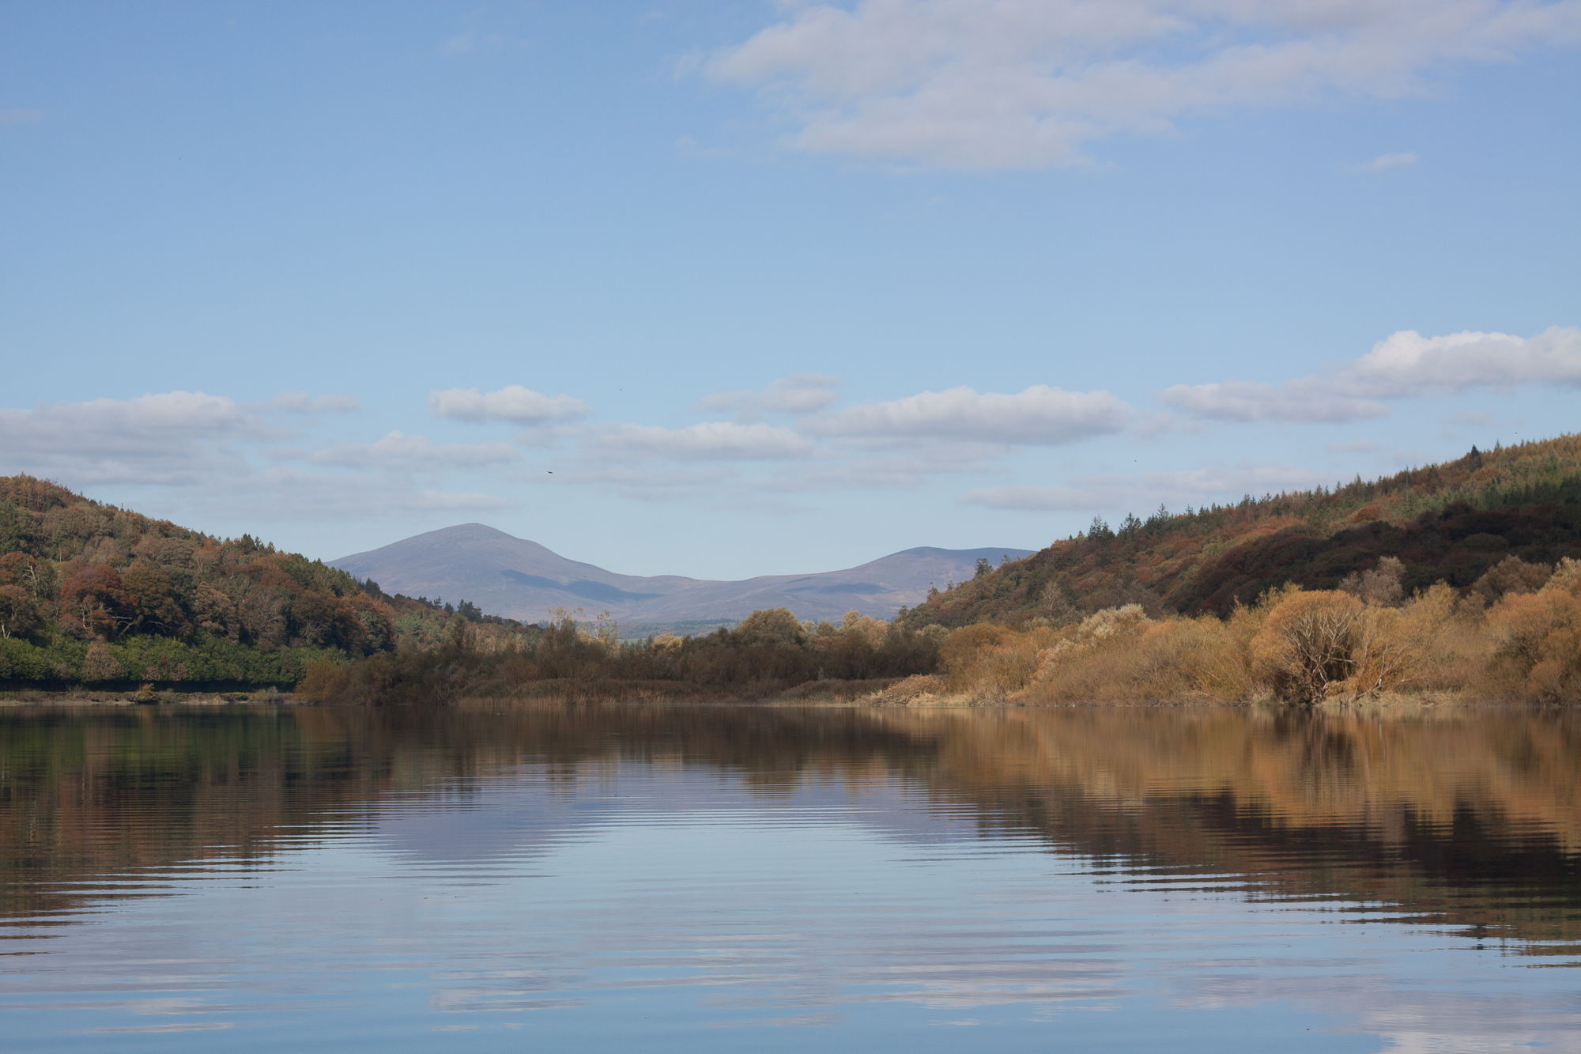
River Blackwater

Slide 2
List of townlands in the study area.
Townland | Logainm | Canon Power | Parish | Barony
Ardsallagh | Height of the willows | Ard Saileach/Willow height | Clashmore | Decies-within-Drum
Ballyheeny | Townland of Sweeney (Uí Shuibhne) | Baile Uí hĺnidh (or Shuibhne) | Clashmore | Decies-within-Drum
Ballynaclash | Townland of the trench/ravine | Baile na Claise/Homestead of the trench | Clashmore | Decies-within-Drum
Ballynatray Demesne | Townland of the strand | Baile na Trá/Strand Homestead | Templemichael | Coshmore & Coshbride
Coolbagh | Corner or nook | Cúl Beathach/ Luxuriant Plot | Clashmore | Decies-within-Drum
D'Loughane |  | Lochtán/An Eminence | Kinsalebeg | Decies-within-Drum
Newport East |  | Port Abha Nua/New Riverbank | Kilcockan | Coshmore & Coshbride
Rincrew | Point/headland | Rinn Crú/Horseshoe Headland | Templemichael | Coshmore & Coshbride
Stael | Strips of land | Strip of land | Templemichael | Coshmore & Coshbride
Strancally | Nose of the hag | Srón na Caillí/The Hag’s Nose | Kilcockan | Coshmore & Coshbride
Templemichael | Church of Michael | Teampaill Mhichíl/St Michael Church | Templemichael | Coshmore & Coshbride

Slide 3
Topographical features located on the banks of the Blackwater
These names were used by the fishermen & women when they were fishing on the river to reference certain strategic points or marks along the reach, usually old Irish names that marked the start and the end of drifts and where each boat would have to wait their turn until the previous boat had drifted a certain distance. None of these names are annotated on any editions of the OS maps.

Slide 4
List of certain strategic points or marks along the reach referred to by fishermen & woman that marked the start and end of drifts
Townland | Name | Direction of fishing based on tides
Rincrew | Cúleen
Stael | Pond | Fished upriver on a rising tide
Ballynatray Demesne | Abbey rock
Ballynatray Demesne | Gravel pit
Ballynatray Demesne | Line na Saggart
Ballynatray Demesne | Bankeen | Fished downriver on a falling tide
Ballynatray Demesne | Point na Coillte
Ballynatray Demesne | Black Trees
Newport East | The Gut
Newport East | Guileen Dubh

Slide 5
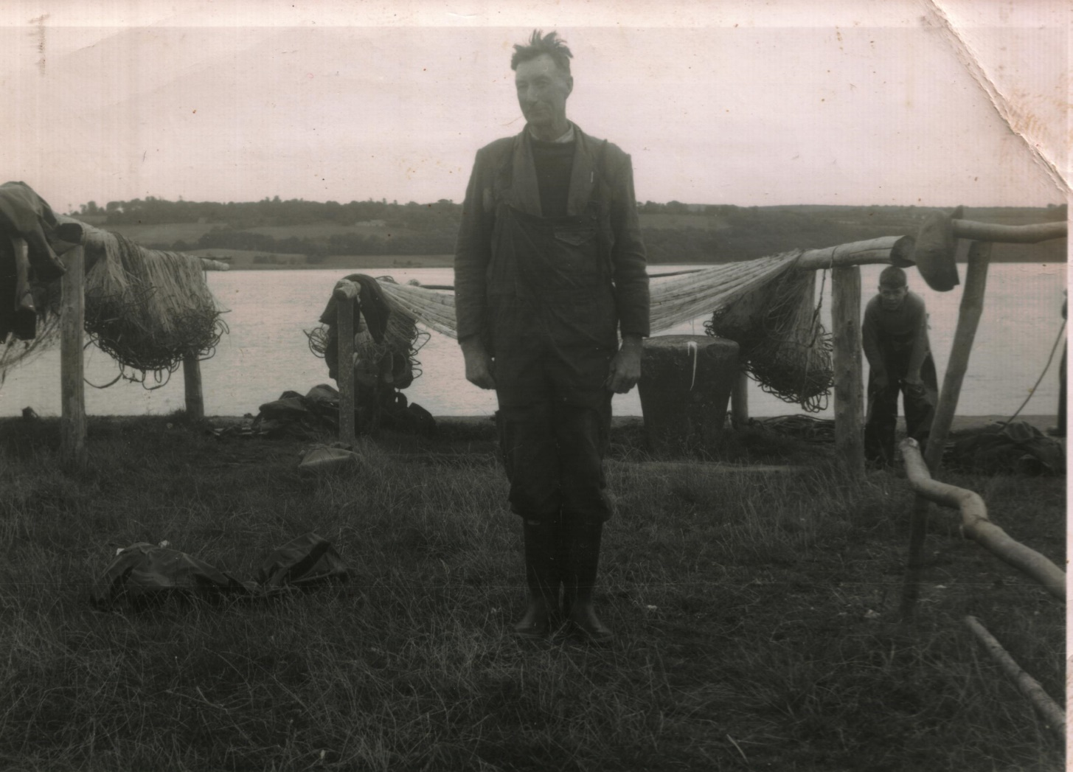
Richard Morrison at Ballynaclash Quay

Slide 6
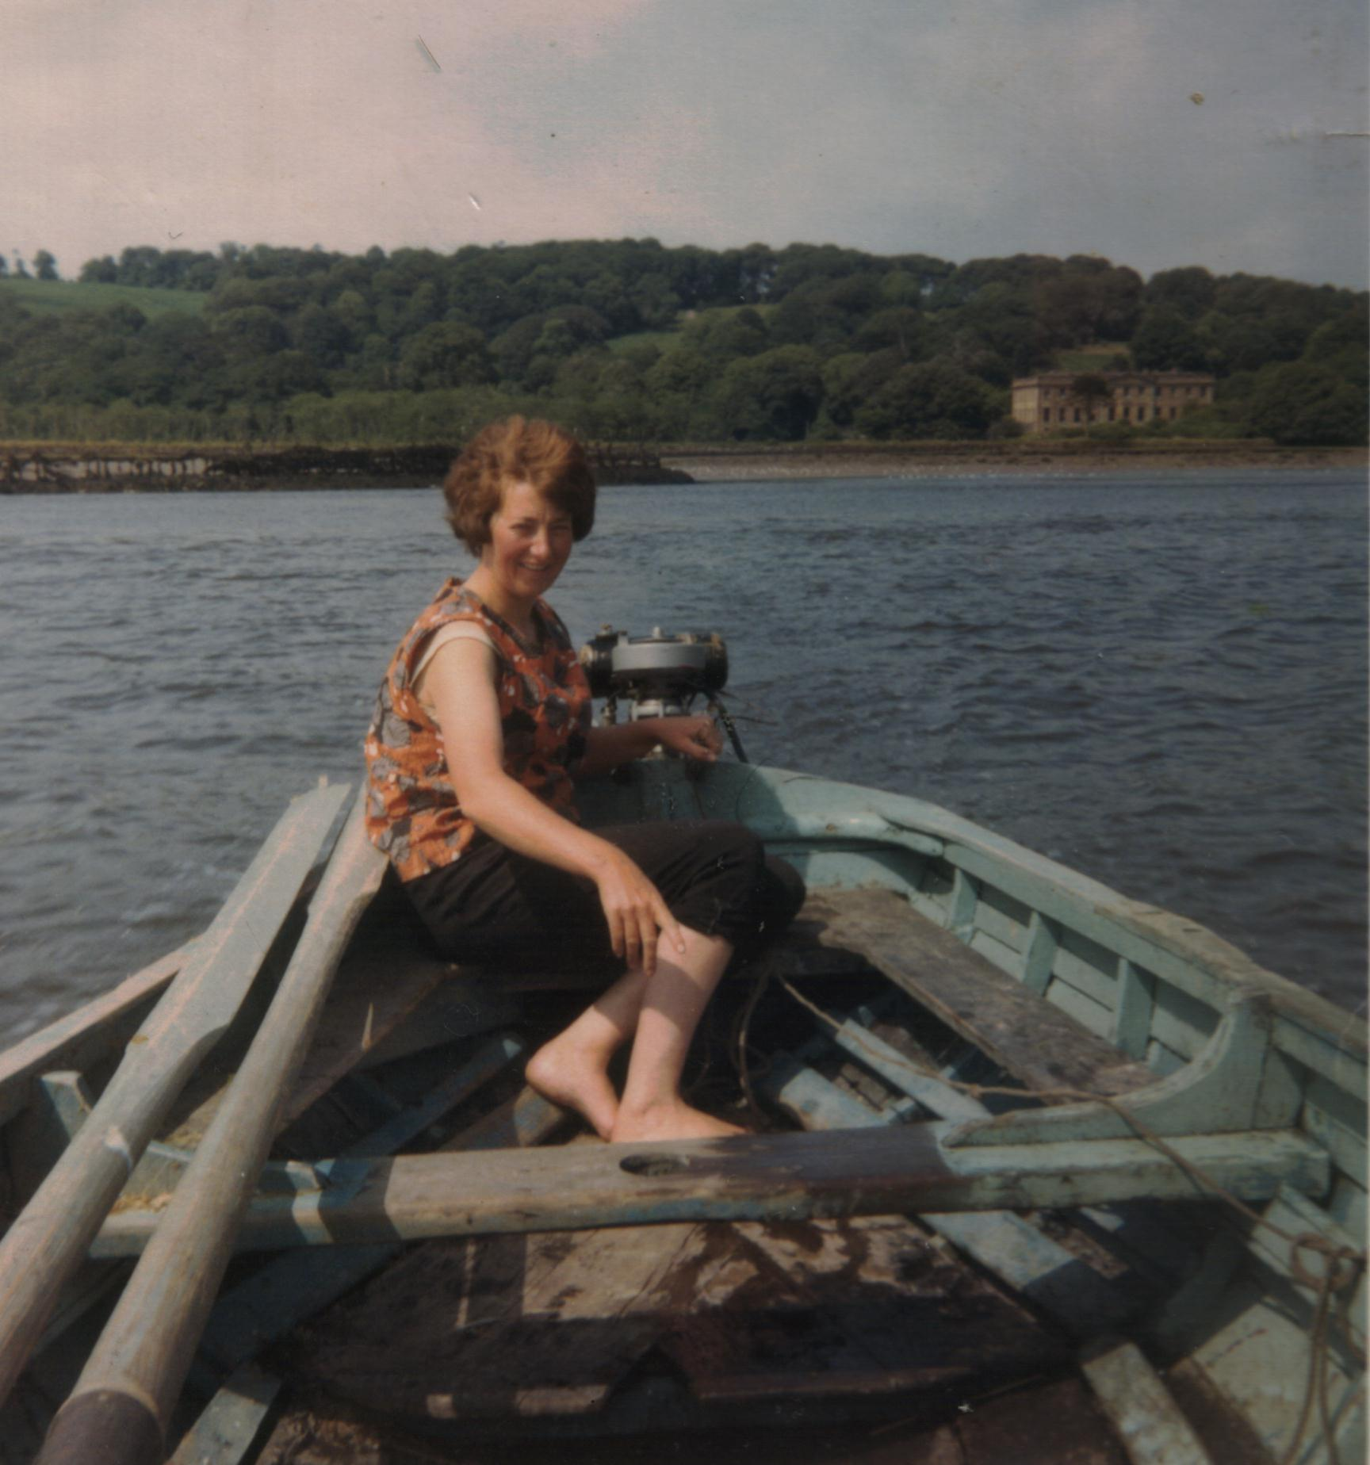
Mary Sheehan in a yawl at work on the Blackwater

Slide 7
List of certain strategic points or marks along the reach referred to by fishermen & woman that marked the start and end of drifts
Townland | Name | Direction of fishing based on tides
Tinnabinna | Barna
Ardsallagh | Carraig Bui
Ardsallagh | Drag stands | Associated with drag fishing
Ardsallagh | Bannock | Fished downriver on a falling tide
Ardsallagh | Long rock
Ardsallagh | Carrig na Gobhar
Ardsallagh | Carrig na Minister
Ardsallagh | Round stone
Ardsallagh | Cúl | Fished downriver on a falling tide

Slide 8
List of certain strategic points or marks along the reach referred to by fishermen & woman that marked the start and end of drifts
D'Loughane/Ardsallagh | Tri Gleanna
D'Loughane | Quarry hole
D'Loughane | Sluice
D'Loughane | The Bank | Fished upriver on a rising tide
Ballyheeny | The Pill | Confluence of the River Licky & Blackwater
Ballynaclash | Porteen point
Coolbagh | Speater

Slide 9
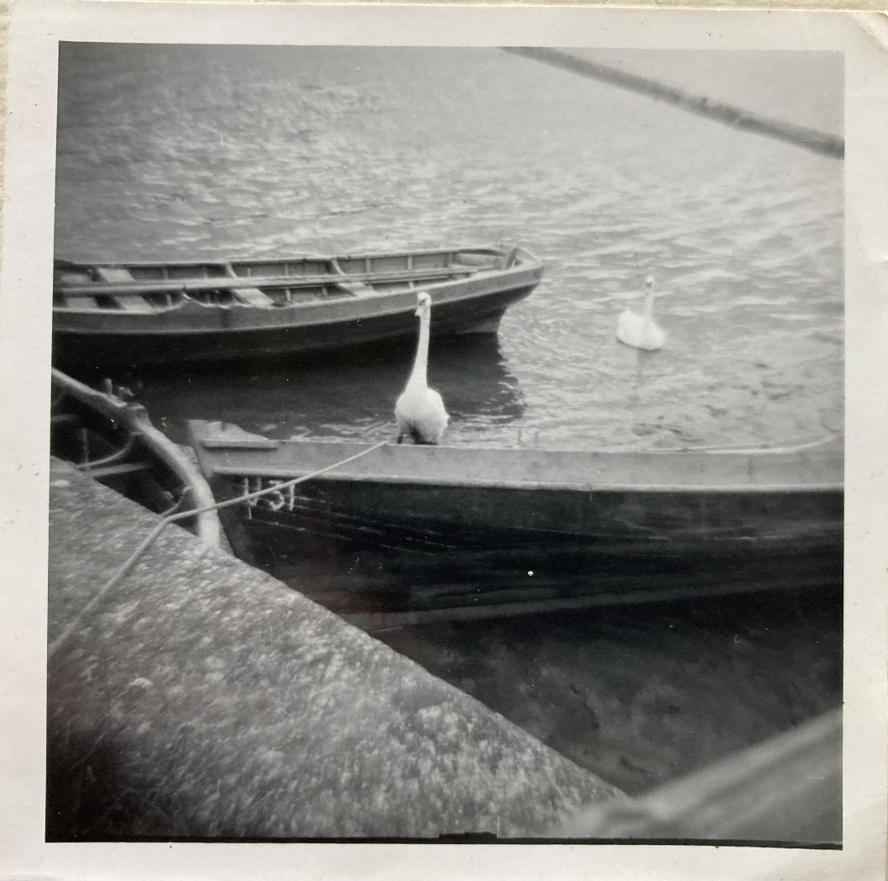
Blackwater Yawls at Ballynaclash Quay

Slide 10
Blackwater Yawls (Mary Sheehan)
The boats were about 17 feet long, carvel built (timber). The boats were hauled up after the season and cleaned and of course during the winter they would dry out and the seams between the planks would open and some of the calking fall out so before they were put out again they would have to be recaulked with oakcup and sealed with pitch and given a coat of tar inside and outside.
The boat builders that I remember were Paddy Buttimer and afterwards Joseph O’Keeffe. I also remember Patsy Osmond built some and a Paddy Quin.
The work to make the boats seaworthy started in January. Around the start of the season the boats and the crews were blessed. It was a lovely little ceremony on each quay. Every boat carried Holy Water, a sprig of palm and a medal. Every day before paying out the nets sprinkling of Holy Water and blessing themselves.

Slide 11
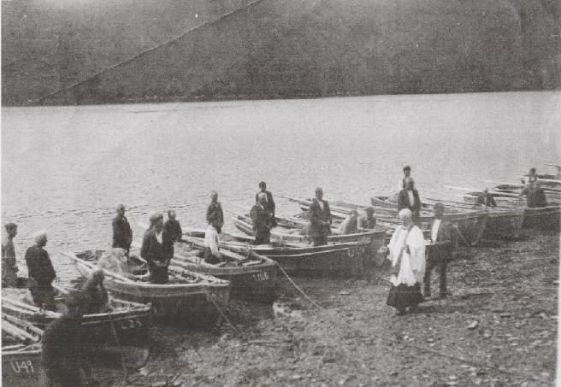
Blessing of the boats c. 1920

Slide 12
List of names given to quays on west bank of Blackwater River
Townland | Name of quay | Ordnance Survey Maps 1st & 2nd editions
Strancally | Strancally quay | Quay marked on 1 ed. & Strancally Quay on 2 ed. map
Strancally | Poulnabeast quay | Quay marked on 1 ed. & 2 ed. map
Strancally | Leahy’s/Lynch’s quay | Quay marked on 2 ed. map
Newport East | Cé Donal | Not annotated on OS maps
Newport East | Hales’ quay | Quay marked on 1 ed. map & 2 ed. map
Ballynatray Demesne | Quay | Quay marked on 1 ed. & 2 ed. map
Templemichael | Quay | Quay marked on 2 ed. map

Slide 13
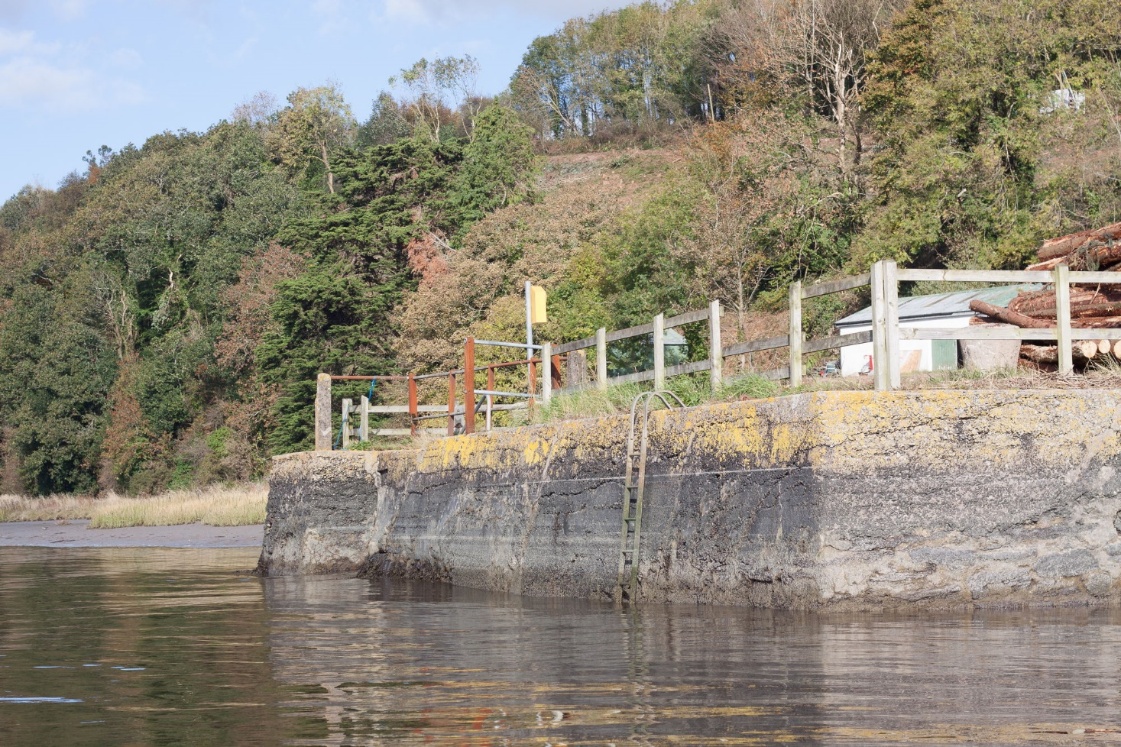
Ballynaclash Quay

Slide 14
List of names given to quays on east bank of Blackwater River
Coolbagh | Coolbagh quay | Coolbagh Quay marked on 2 ed. map
Coolbagh | Quay | Quay marked on 2 ed. map
Ballynaclash | Ballynaclash quay | Quay marked on 1 ed. & Ballynaclash Quay on 2 ed. map
Clashmore/Ballyheeny | Raheen quay | Quay marked on 2 ed. map
Clashmore | Clashmore House quay | Quay marked on 2 ed. map
D’Loughane | Loughtane quay | Boat quay marked on 1 ed. map
D'Loughane/Ardsallagh | Brien’s quay | Not annotated on OS maps
Ardsallagh | McCormack’s quay | Not annotated on OS maps
Ardsallagh | Ferry Quay | Quay marked on 2 ed. map
Ardsallagh | Quay | Quay marked on 2 ed. map
Ardsallagh | Quay | Boat quay marked on 1 ed. map & quay pm 2 ed. Map
Ardsallagh | Quay | Not annotated on OS maps

Slide 15
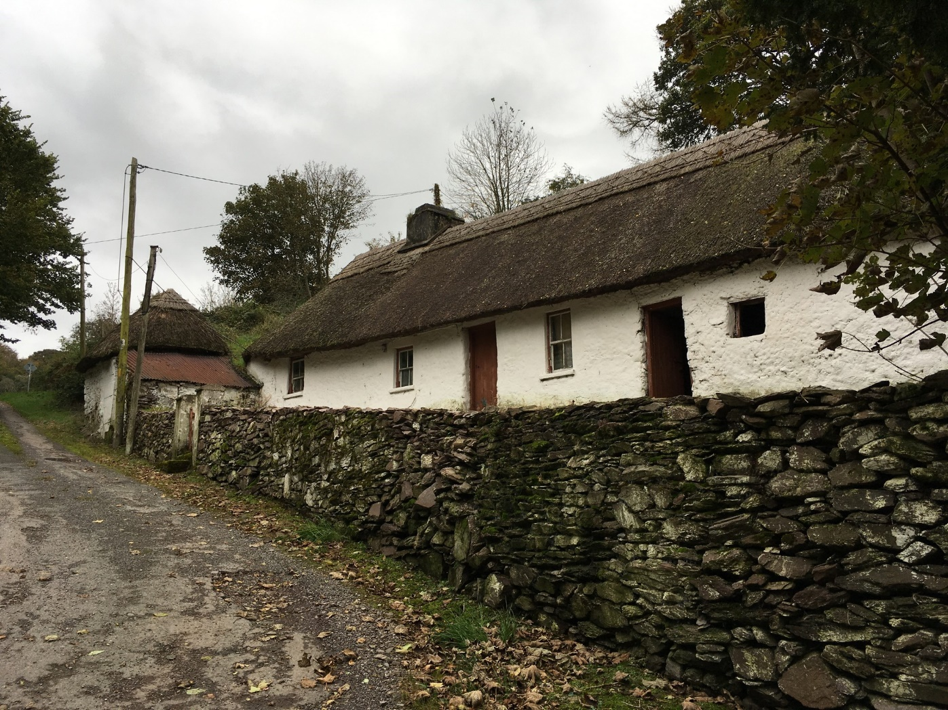
Flemming’s at Ardsallagh

Slide 16
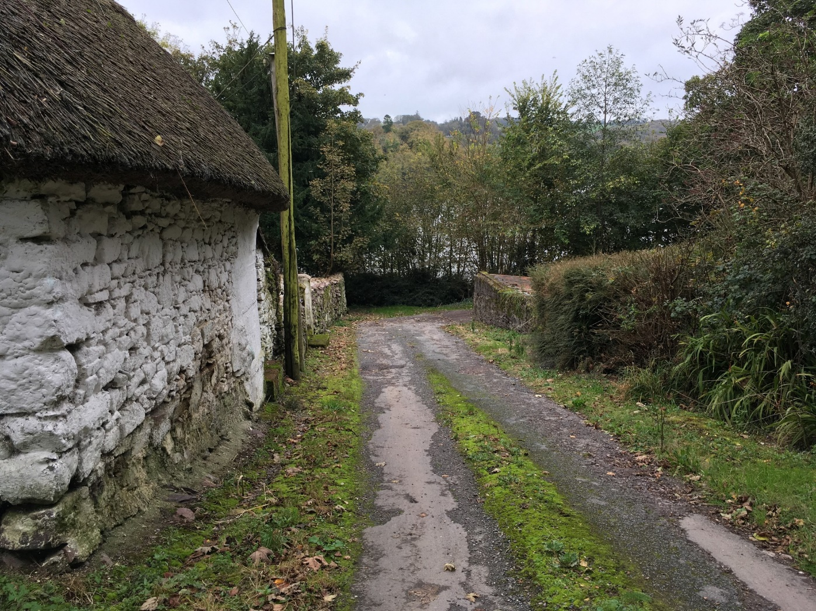
Road to Ardsallagh or Ferry Quay

Slide 17
Weirs on the Blackwater River
The fishermen and women who worked on the Blackwater River referred to 11 of the weirs by name, 4 of these are annotated fish weir on the OS maps, an additional 3 are annotated on Griffith Valuation map and 4 are not marked on any editions of the OS maps. Two of the weirs are referred to by the name of the townland – Stael and Loughtane. Three of them are referred to by a personal name – Paddy’s, George’s and Mary Ann’s. It can be seen on the 1860 revision book extracts (Griffith’s Valuation) that Mary-Anne Ronayne (Dennehy) had taken over the Ballynaclash Weir (one of the weirs) around 1860. A further 3 are referred to by surnames – Hurley’s, Keeffe’s and Allen’s. How many of the personal first or surnames can be cross refenced to families who lived on the banks of the river. The O’Keeffe family at Ballynaclash quay is one such example.
A second example is Allen’s weir When the last of the Ronaynes left D’Loughtane in 1854 the estate was sold in 1856 to a Samuel Allen through the Encumbered Estates Commission which was set up after the famine to handle the sale of distressed estates. Samuel Allen developed a bank and drainage system along the bank of the Blackwater and Licky rivers which bounded the estate. He also gave his name to the new Allen’s Quay on the Blackwater River.

Slide 18
The fishermen and women who worked on the Blackwater River referred to 11 of the weirs by name, 4 of these are annotated fish weir on the OS maps, an additional 3 are annotated on Griffith Valuation map and 4 are not marked on any editions of the OS maps. Two of the weirs are referred to by the name of the townland – Stael and Loughtane. Three of them are referred to by a personal name – Paddy’s, George’s and Mary Ann’s. It can be seen on the 1860 revision book extracts (Griffith’s Valuation) that Mary-Anne Ronayne (Dennehy) had taken over the Ballynaclash Weir (one of the weirs) around 1860. A further 3 are referred to by surnames – Hurley’s, Keeffe’s and Allen’s. How many of the personal first or surnames can be cross refenced to families who lived on the banks of the Blackwater. The O’Keeffe family at Ballynaclash quay is one such example.
A second example is Allen’s weir When the last of the Ronaynes left D’Loughtane in 1854 the estate was sold in 1856 to a Samuel Allen through the Encumbered Estates Commission which was set up after the famine to handle the sale of distressed estates. Samuel Allen developed a bank and drainage system along the bank of the Blackwater and Licky rivers which bounded the estate. He also gave his name to the new Allen’s Quay on the Blackwater River.

Slide 19
List of weirs on the west bank of the Blackwater River between Coolbagh quay and Youghal bridge
Townland | Name of weir | Ordnance Survey Maps & Griffith Valuation Maps
Strancally | Parceen weir | Not annotated on OS maps
Strancally/Newport East | Paddy’s weir | Fish weir marked on 1st ed. OS map
Newport East | Hurley’s weir | Fish weir marked on 1st ed. OS map
Ballynatray Demesne | Fish weir | Fish weir marked on 1st ed. OS map
Ballynatray Demesne | Spratt weir | Fish weir marked on 1st ed. OS map
Ballynatray Demesne | Black weir | Fish weir marked on 1st ed. OS map
Templemichael | Fish weir | Fish weir marked on 1st ed. OS map
Stael | Fish weir | Fish weir marked on 1st ed. OS map
Stael | Stael Fish weir | Fish weir marked on 2 ed. OS map
Rincrew | Holly bush weir | Not annotated on OS maps

Slide 20
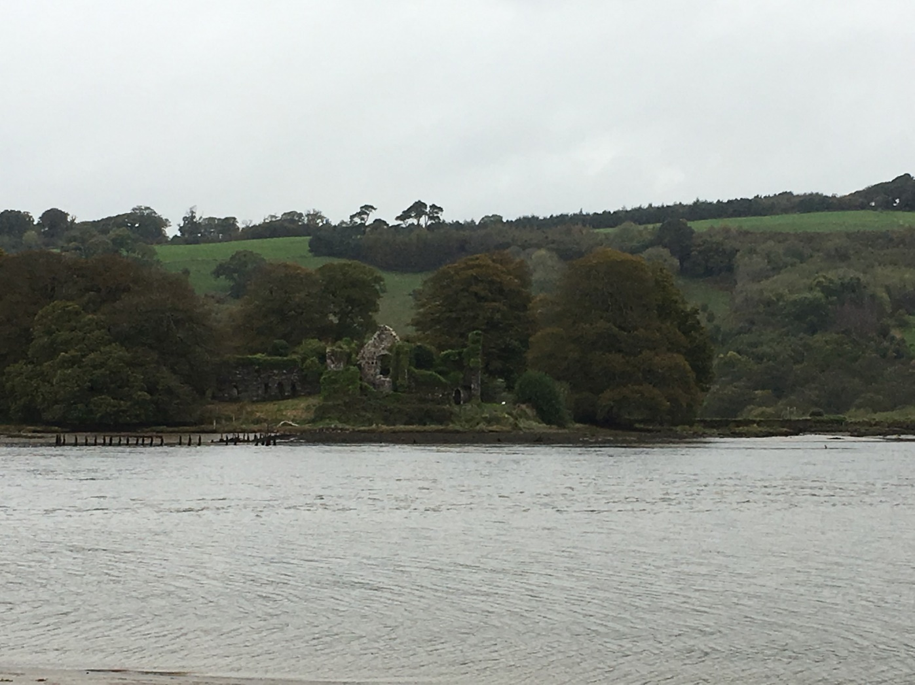
View of Molana Abbey & weir from Ardsallagh Quay

Slide 21
List of weirs on the east bank of Blackwater River between Coolbagh quay and Youghal bridge
Townland | Name of weir | Ordnance Survey Maps & Griffith Valuation Maps
Coolbagh | George’s weir | Annotated as 8 on Griffith Valuation map
Ballynaclash | Mary Ann's weir | Annotated as 9 on Griffith Valuation map
Ballynaclash | Keeffe’s weir | Annotated as 10 on Griffith Valuation map
D'Loughane | Allen’s weir | Not annotated on OS maps
D'Loughane | Loughtane weir | Not annotated on OS maps
Ardsallagh | Fish weir | Fish weir marked on 1st ed. OS map
Ardsallagh | Fish weir | Fish weir marked on 1st ed. OS map
Ardsallagh | Fish weir | Fish weir marked on 1st ed. OS map

