Slide 1
Ice House History of Clashmore/Kinsalebeg
Dúchas project
Local History & Folklore
Brian Dunne Culture and Heritage studies 2021/2022

Slide 2
Introduction
The why, who, where, when and how of Ice in my locality.
This presentation will hope to inform you of the main reasons why ice houses existed and also paint a picture of how 18th and 19th century industry and trade operated.
I will focus mostly on ice production in my own parish. We will also introduce the people or characters involved in the industry and what their standing in society was at the time.
To keep this presentation interesting and informative it will be mostly visual with maps, pictures, brief extracts and sketch's making up the main body of research.
Feel free to ask questions during or after presentation and I hope its informative.

Slide 3
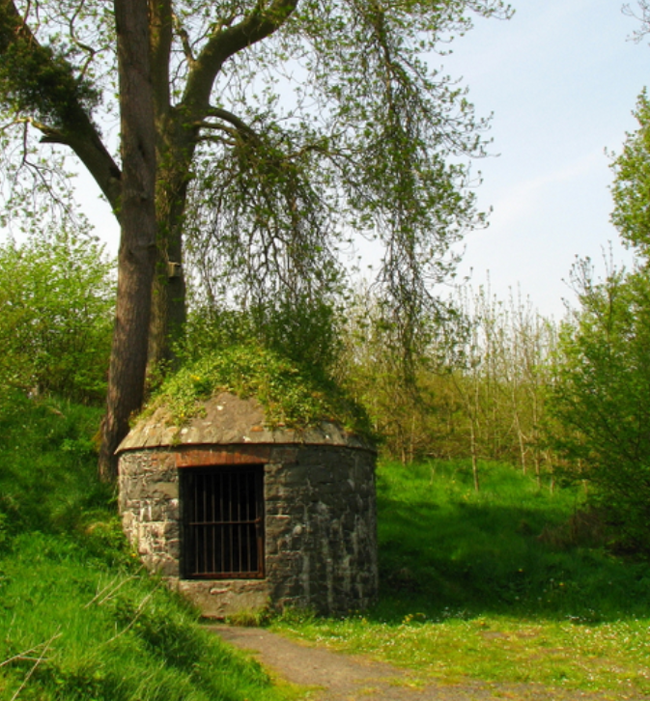
Brief Ice House Description
Ice houses had two main functions.
1= Food preservation.
2= Ice preservation.
They were built of stone or brick, with the roofs either stone, brick, slate or thatch.
The first recorded in Britain or Ireland was in 1619. King James the 1st in Greenwich Park.
Mostly built in Ireland in the late 18th and into the 19th century.
A large portion of the Ice Houses of Ireland are in the big house estates.
Ice House, Carnfunnock Country Park (Antrim)

Slide 4
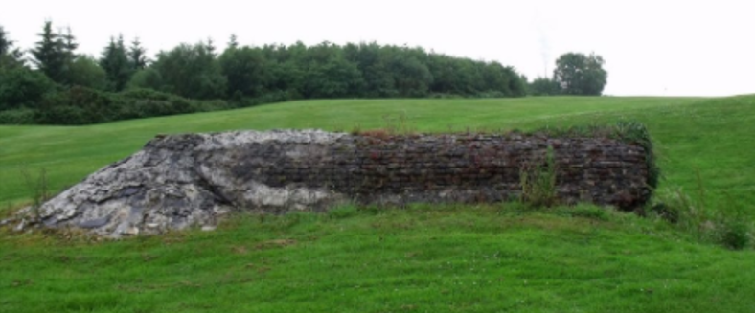
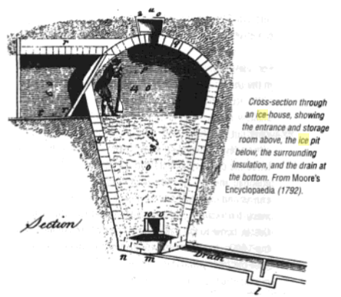
In most cases 1/3 of the chamber was above ground with 2/3 below.
A passageway of varied length to repel heat had 1,2 or sometimes 3 doors.
Access hatch's were built into some to allow daily usage.
Faithlegg house estate.
A typical ice house would have had an egg shaped pit or chamber with an internal height of 10/15 feet.
A internal diameter of 8 or 10 feet was common, with passageways of 5 or 6 feet.
The structure would be covered over with soil and subsequent vegetation in a lot of cases.

Slide 5
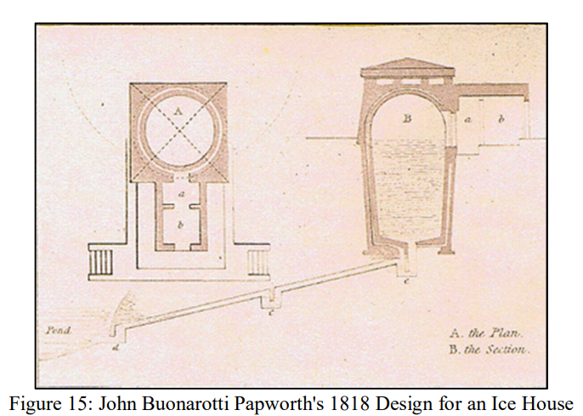
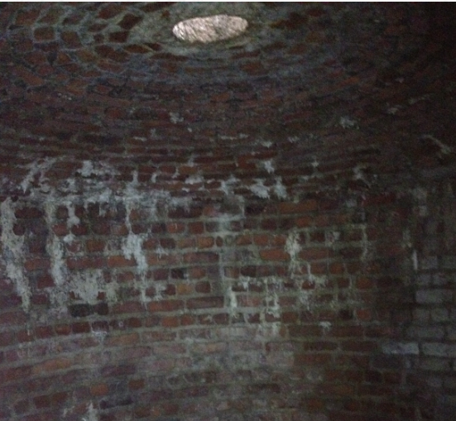
Drains to allow any melted water escape.
Water will melt ice quicker than natural heat.
Other technology included a sump on the drains to stop warm air rising up drain.
Bottom concaved floor had a cartwheel laid over drain hole to keep it clear.
Straw or sawdust was also used to insulate ice from the chambers floor and walls. (also at doors)
Cavity walls were rare but used as insulation and for drainage.(100 years before houses!)
Food at (a)
Straw at (b)
Access hole

Slide 6
List of ice and ice house uses.
Preservation of fish, poultry, bacon and game for domestic use.
Used to cool drinks.
The preparation of ice-cream and sorbet deserts.
In lofts over bacon as its being cured. (Larger facility's)
Supplying hospitals and doctors to aid healing from injury's. (Fever reduction)
Preserving foods for export journeys.
Helped landlords show off their wealth and grandeur.
Increases milks shelf life.
Butter and vegetable's kept fresher.
As air raid shelters during world war 1 and 2.

Slide 7
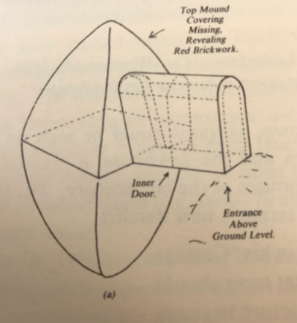
Ice House construction criteria
Entrance north facing.
Passageway.
2/3 doors.
Near lake or ice supply.
Access and roadways important, (horses).
Egg or rugby ball shape for strength.
Do’s
Don’ts
Not under trees, (damp)
Good drainage below chamber drain.
No lodging meltwater.
Don’t build where there is no supply of building stone.

Slide 8
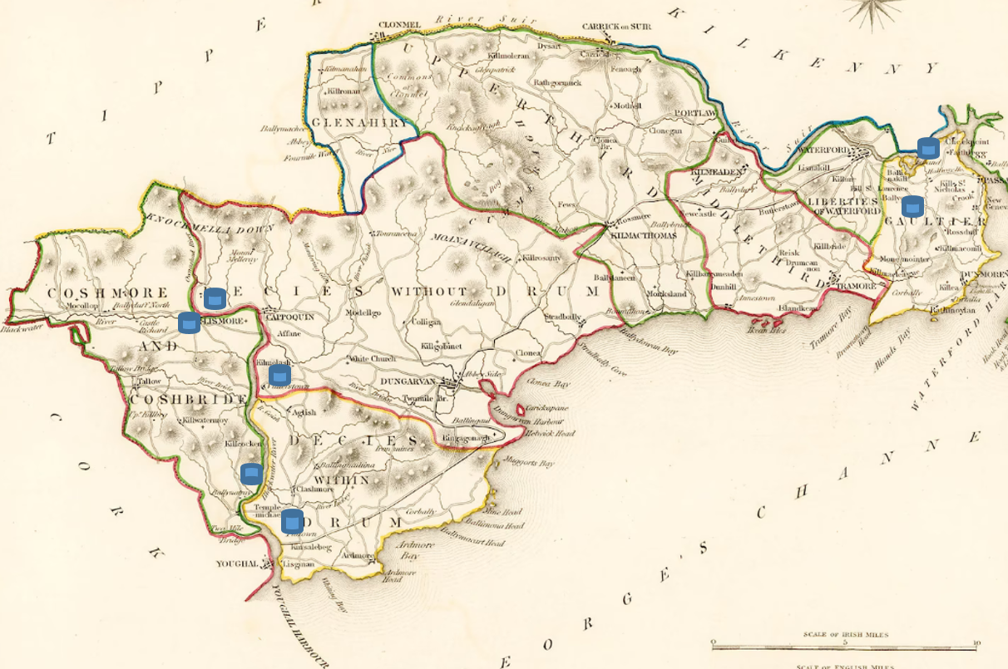
Existing Ice Houses in Waterford(possible more undocumented)

Slide 9
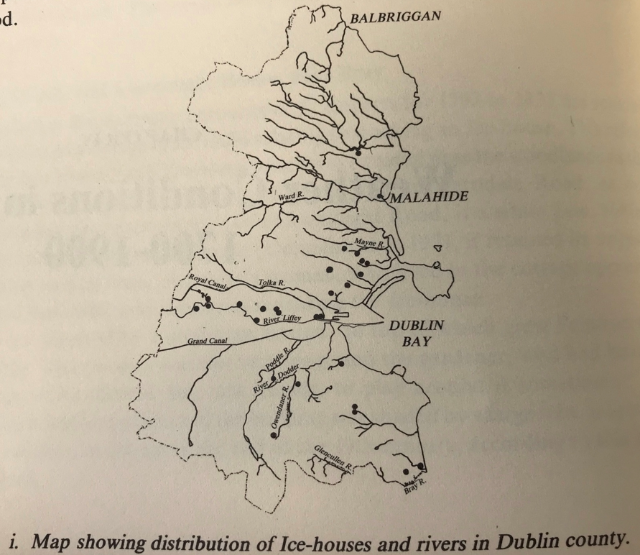
Ice House numbers in Dublin (28)
Comparison guide
Ice imported.
Wenham ice.
Norwegian ice.
Keep replacing.
Distribution.
Máiréad M. Johnston (1988)

Slide 10
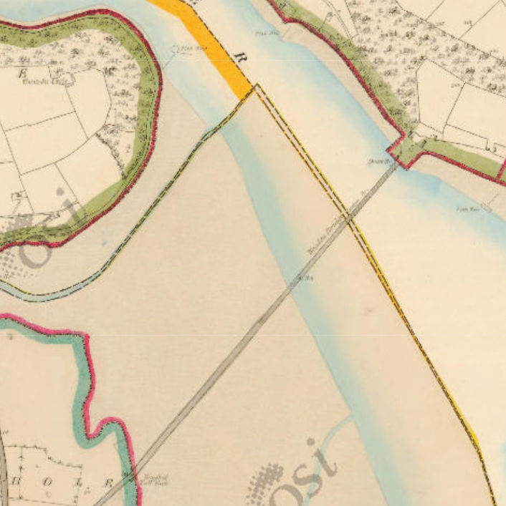
Why did ice production flourish in Clashmore / Kinsalebeg !
1: The Bridge
Build started 1829.
Completed 1832.
Transport of goods was improved between Waterford and Youghal.
16 mile reduction from going by Lismore bridge.
A dangerous crossing from ferry point was the other option at the time.
First edition map (1840)

Slide 11
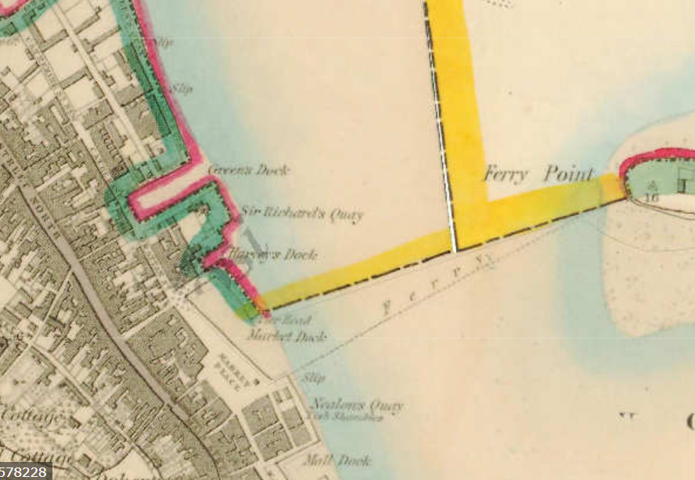
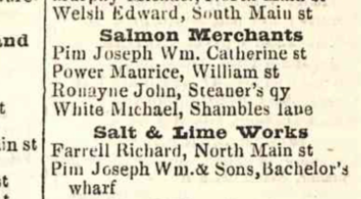
Youghal had a large scale harbour with ships being fed goods daily by the towns merchants.
Trade of fish by boat to Cork and other southerly towns was common.
Prized Blackwater Salmon also shipped to Bristol and other English city's at times.
2 : Youghal port/harbour
First Edition map (1840)
Youghal business directory, 19th century

Slide 12
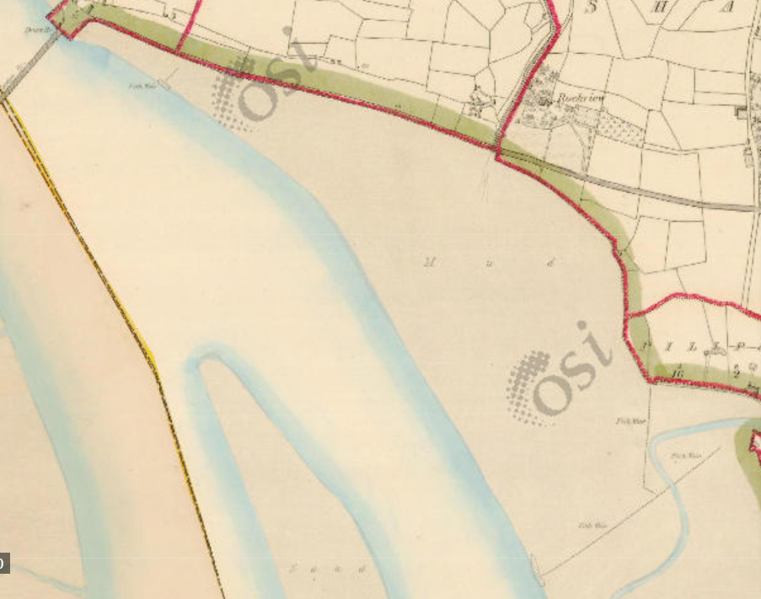
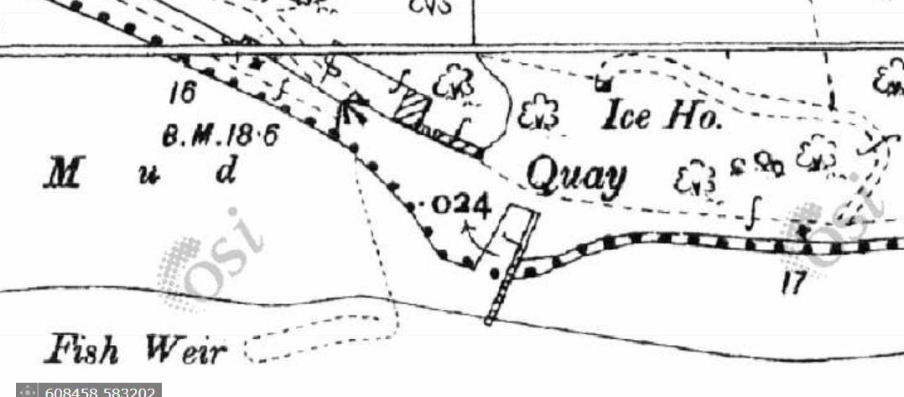
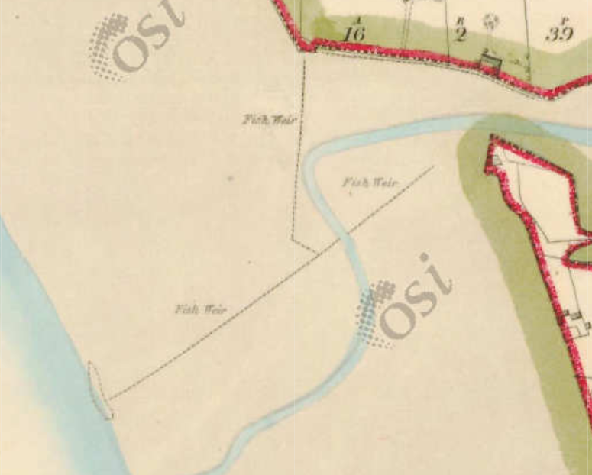
3 : The Fishing industry on the Blackwater
Fish Weirs

Slide 13
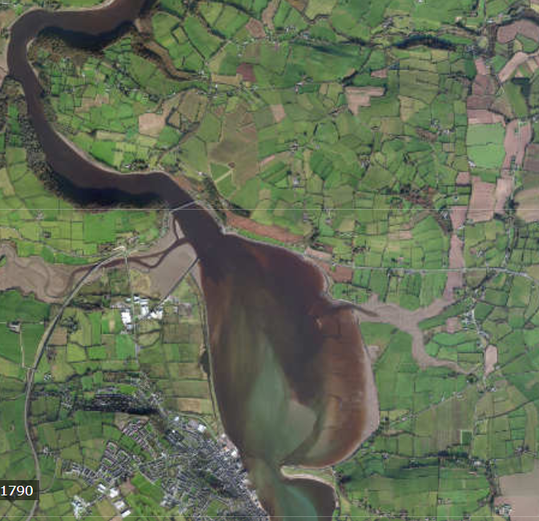
What's in place.
1 : Transport.
Bridge.
2 : Trade.
Youghal.
3 : Fishing.
Fish + Salmon
4 : Ice.
Final piece of
the puzzle.
What’s missing?

Slide 14
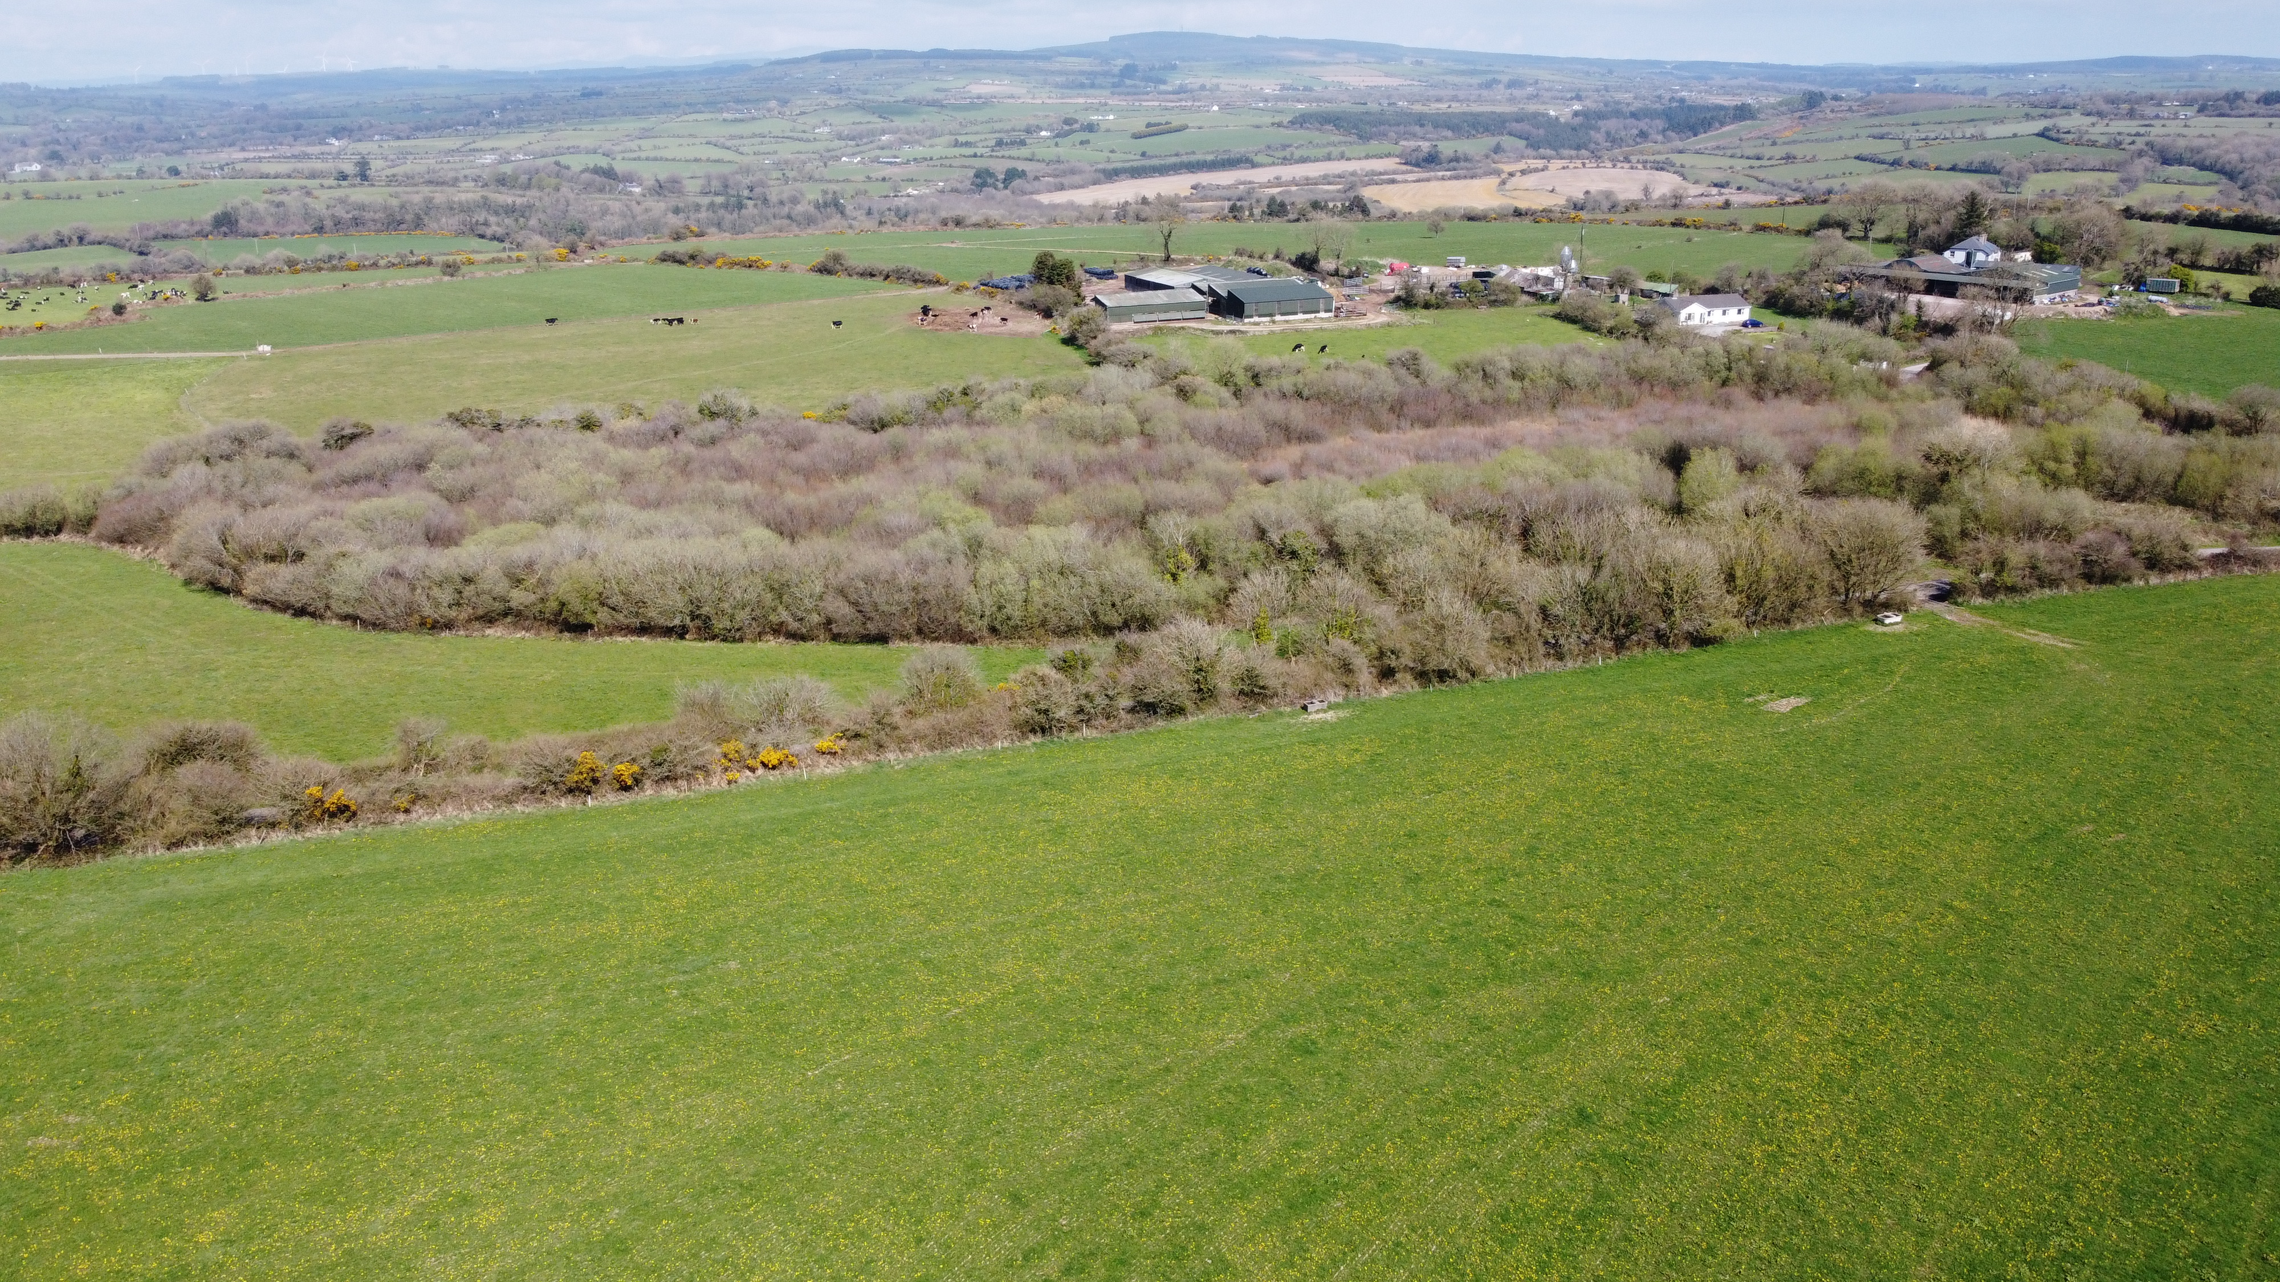
4 acre wooded marsh in Kilmaloo, Clashmore.

Slide 15
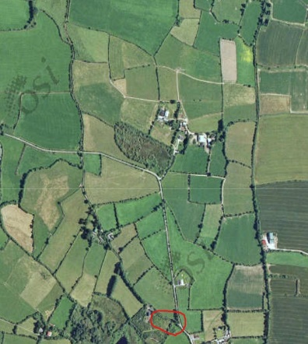
(1) The Ice House (Red)

Slide 16
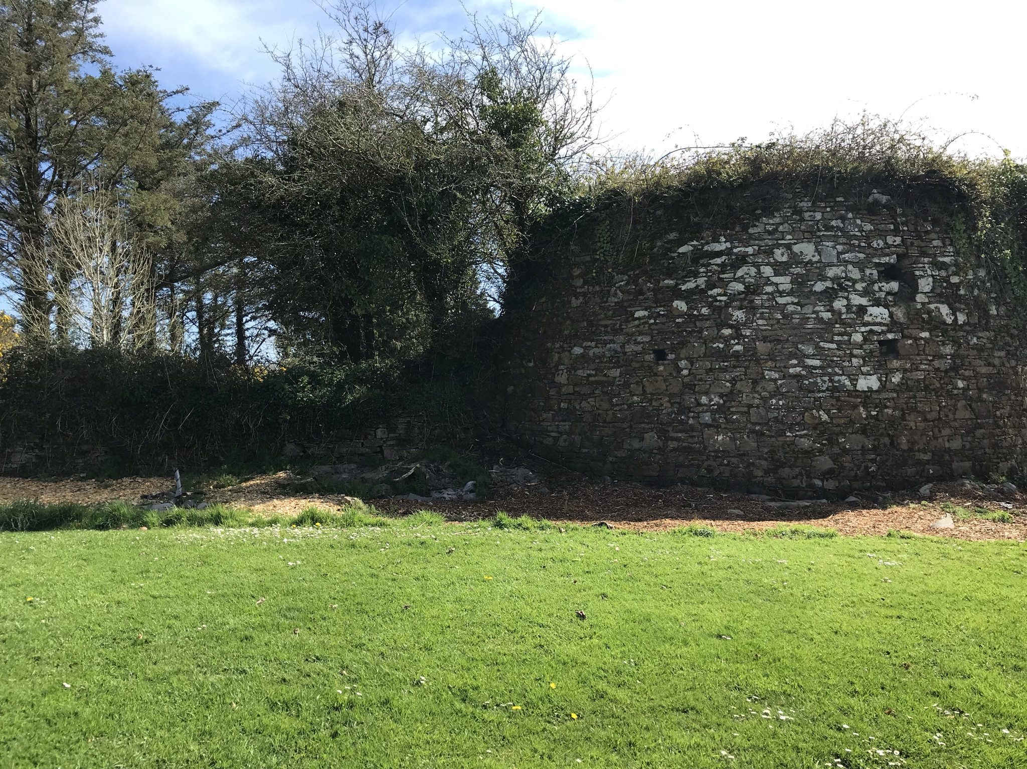
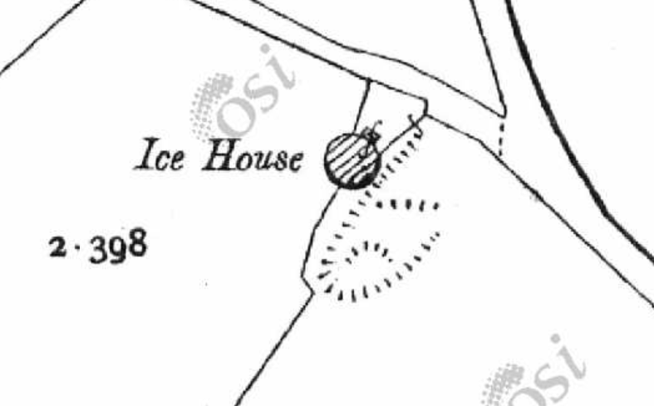
Ice House marked red (McKennas)
Built between first edition map print( not shown) and in Griffiths valuation in 1851,(Power paid the landlord Declan Treacy £12 1851)
Miss Mullins land(19th C)
Declan Tracey Landlord/Agent
Owners : Maurice Power
Richard Carey
Richard Farrell/agent
Current landowner
Ithel McKenna
2nd edition map

Slide 17

(2) The Ice House (Green)

Slide 18
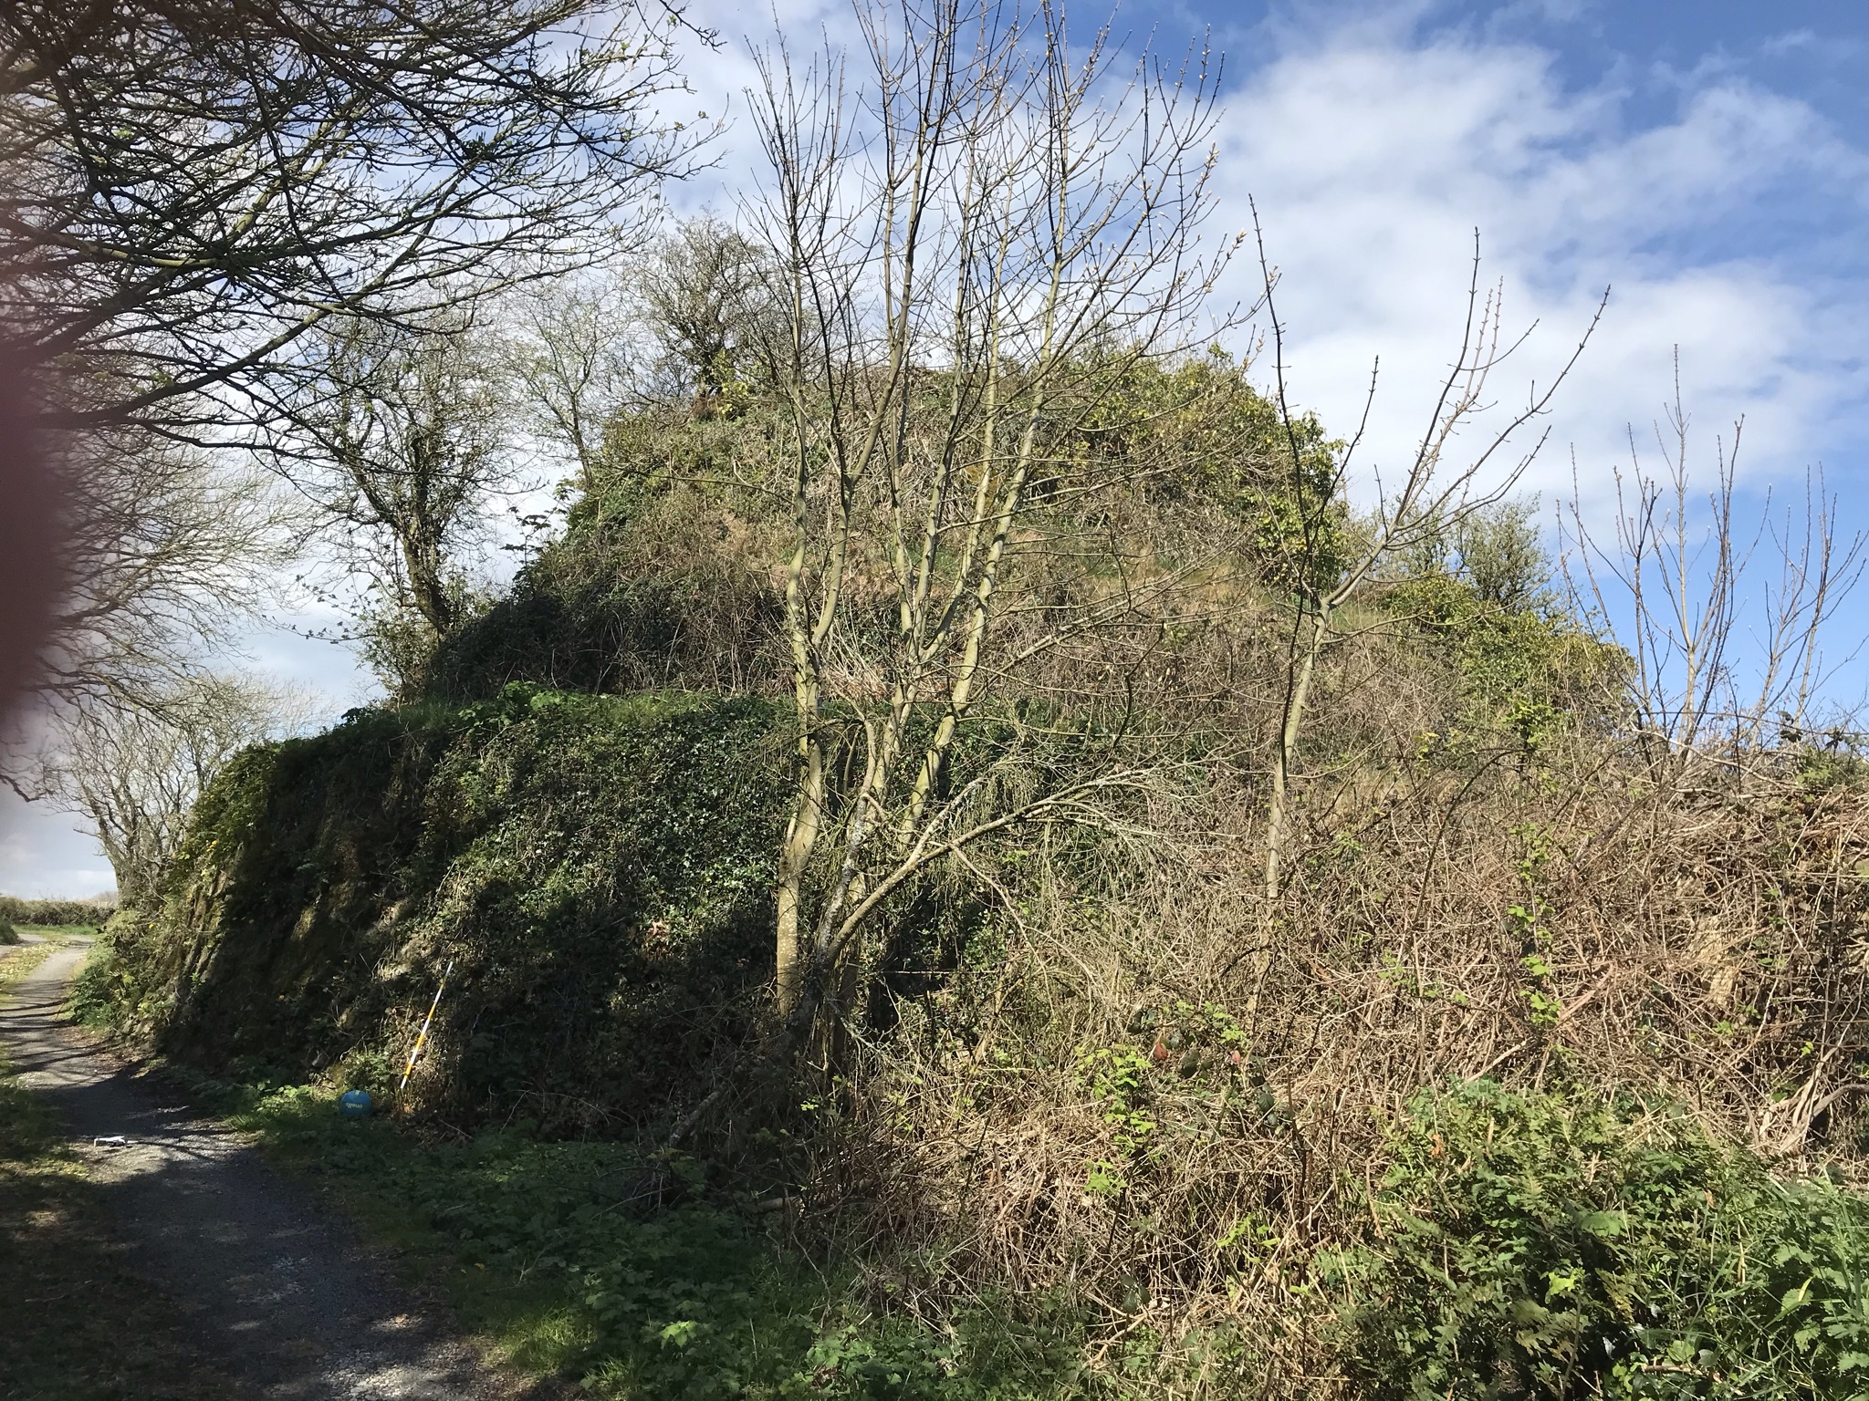
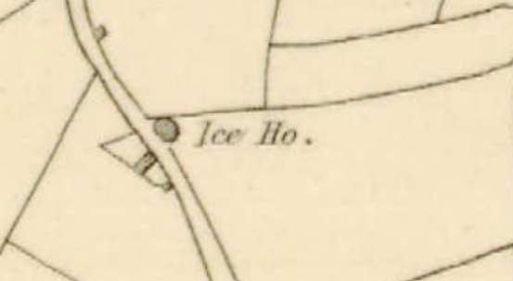
Ice House marked in green (Murrays)
Built in early part of 1800’s
Sean Connors land (19th C)
Declan Tracey Landlord/Agent
Owners : Thomas Ronayne
John Ronayne
Alice Ronayne
Robert Ronayne
John Atkinson
Current landowner
James Oliver Murray
1st edition map

Slide 19
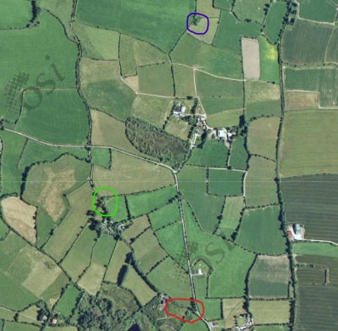
(3) The Ice House (Blue)

Slide 20
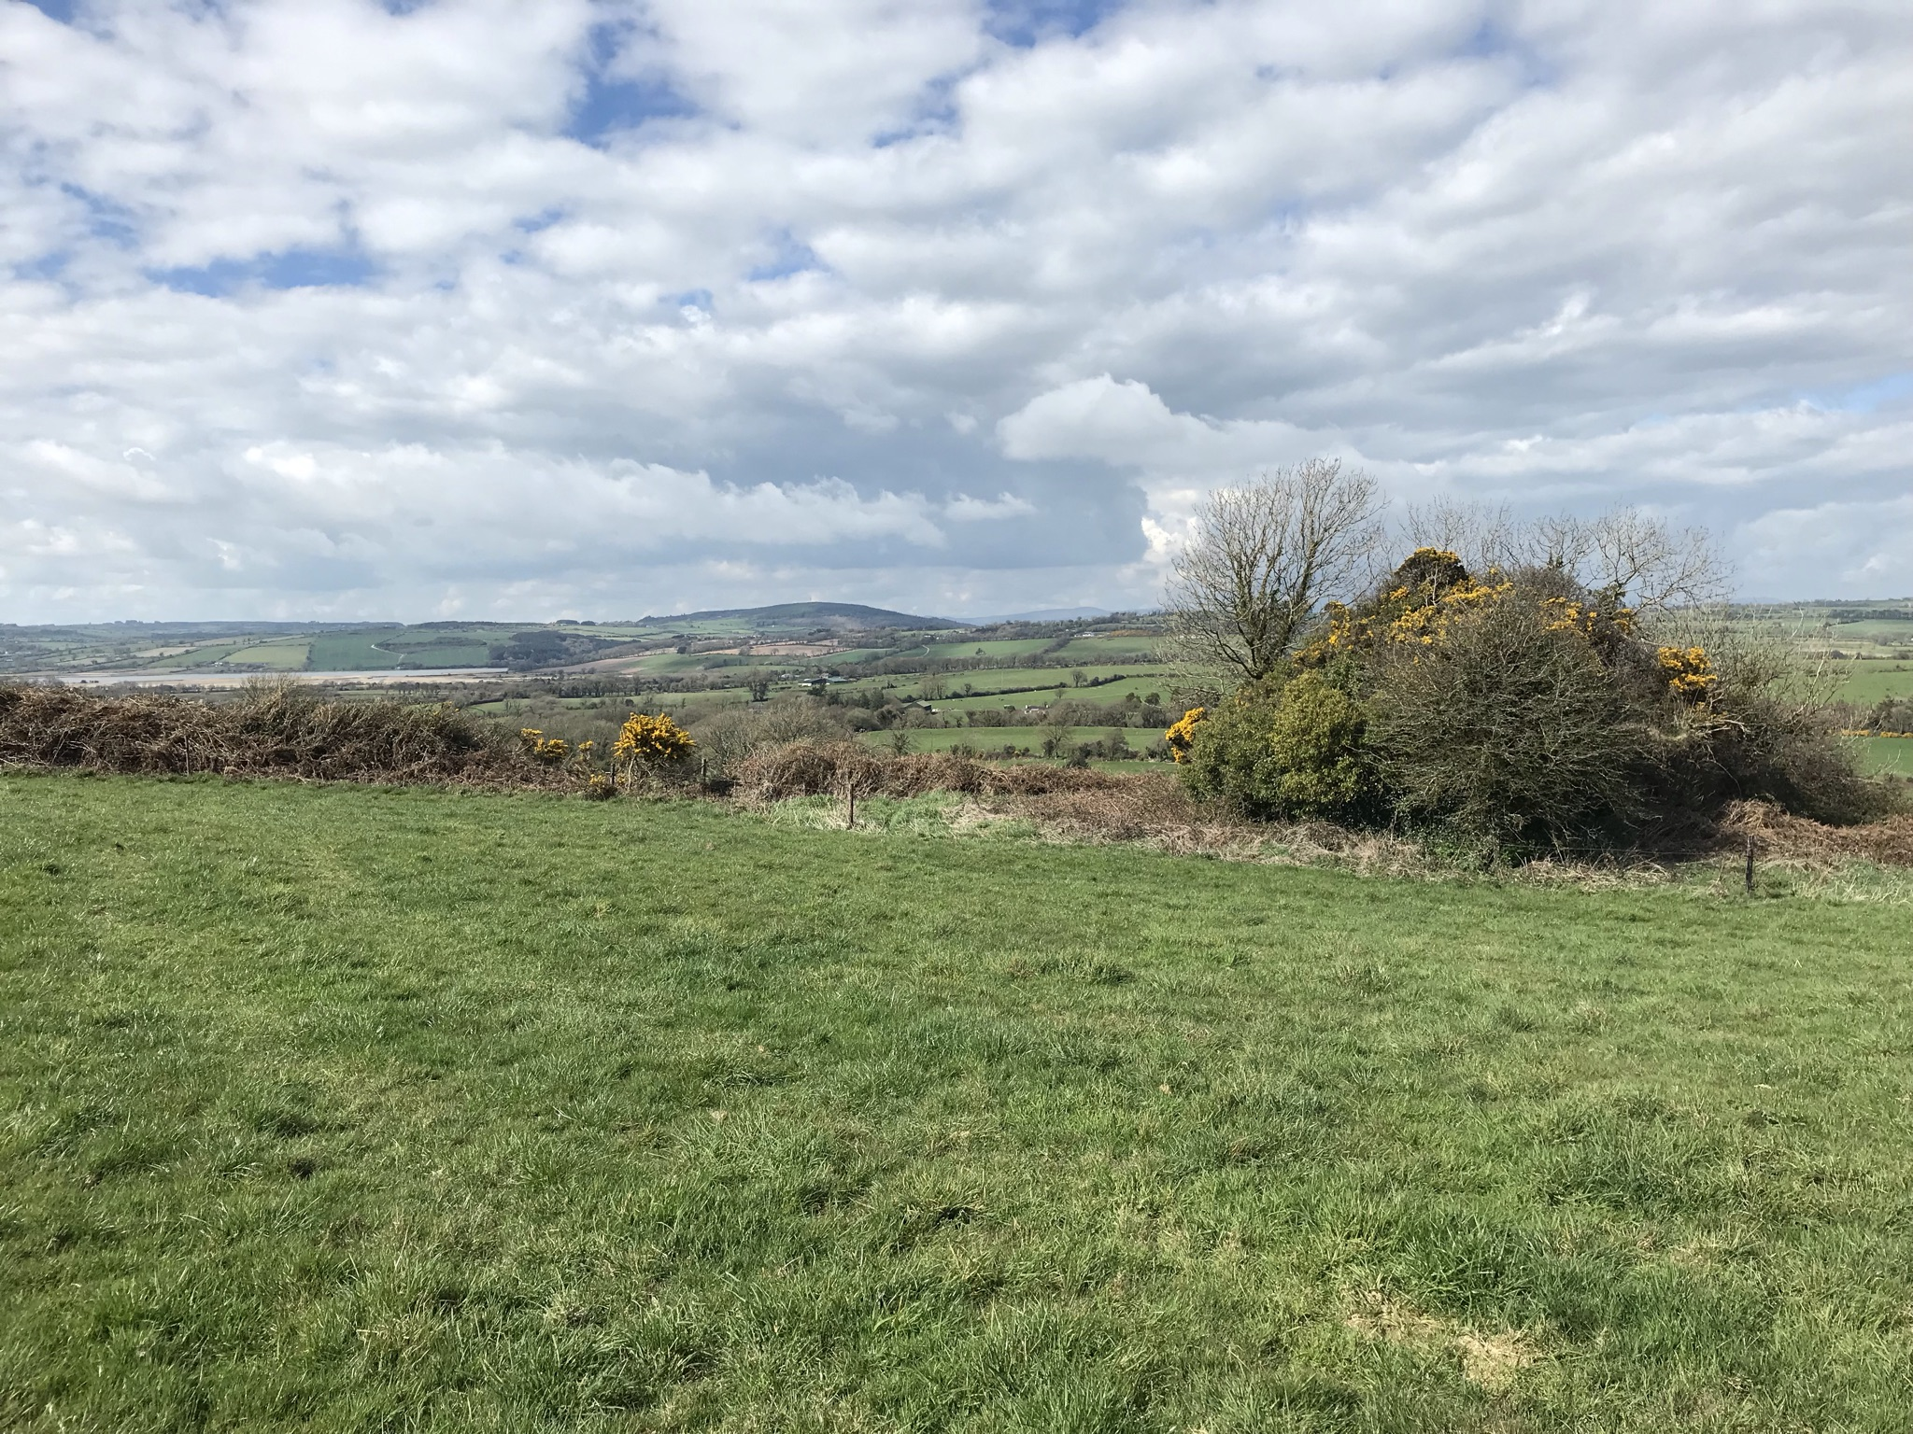
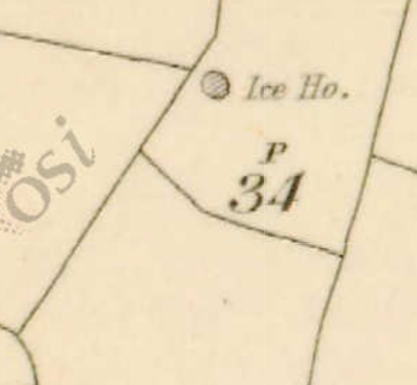
Ice House marked in Blue (Halloran’s)
Built in early part of 1800’s
Richard Tobin's land
Charles Devalmare Landlord/Agent
Owners : Micheal White
Mary Tobin
Margaret Tobin!
Jeremiah Tobin!
William O Neill!
Current landowner
Pat o Halloran
1st Edition map

Slide 21
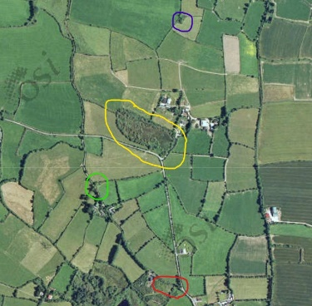
Kilmaloo Lough (yellow)

Slide 22
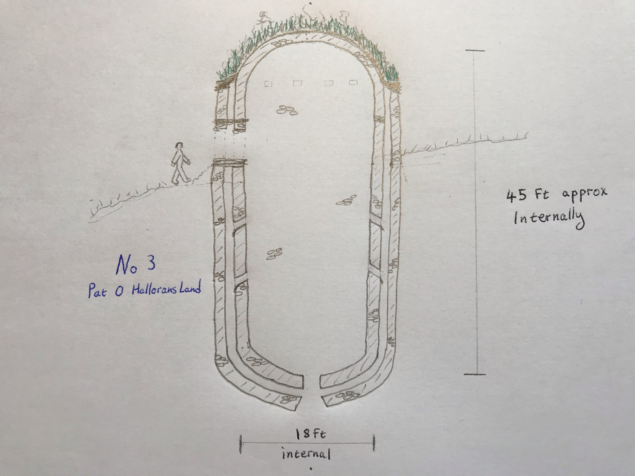
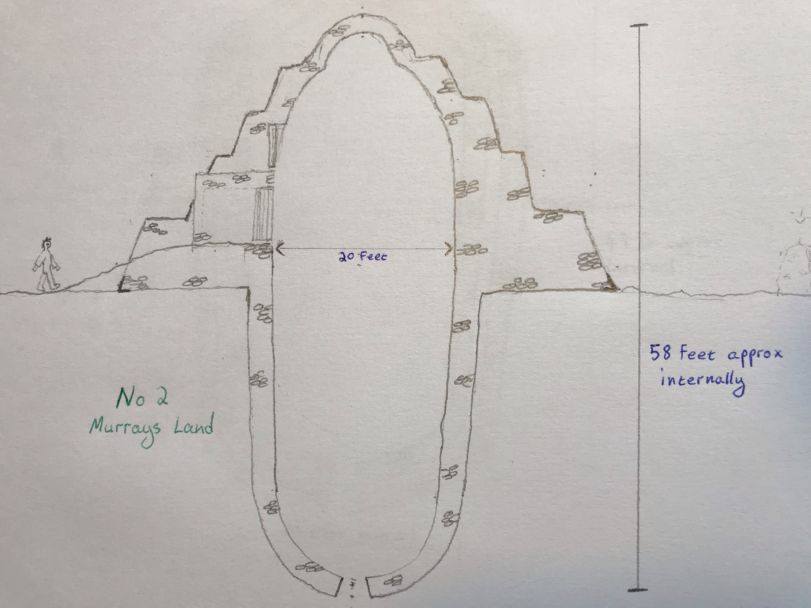
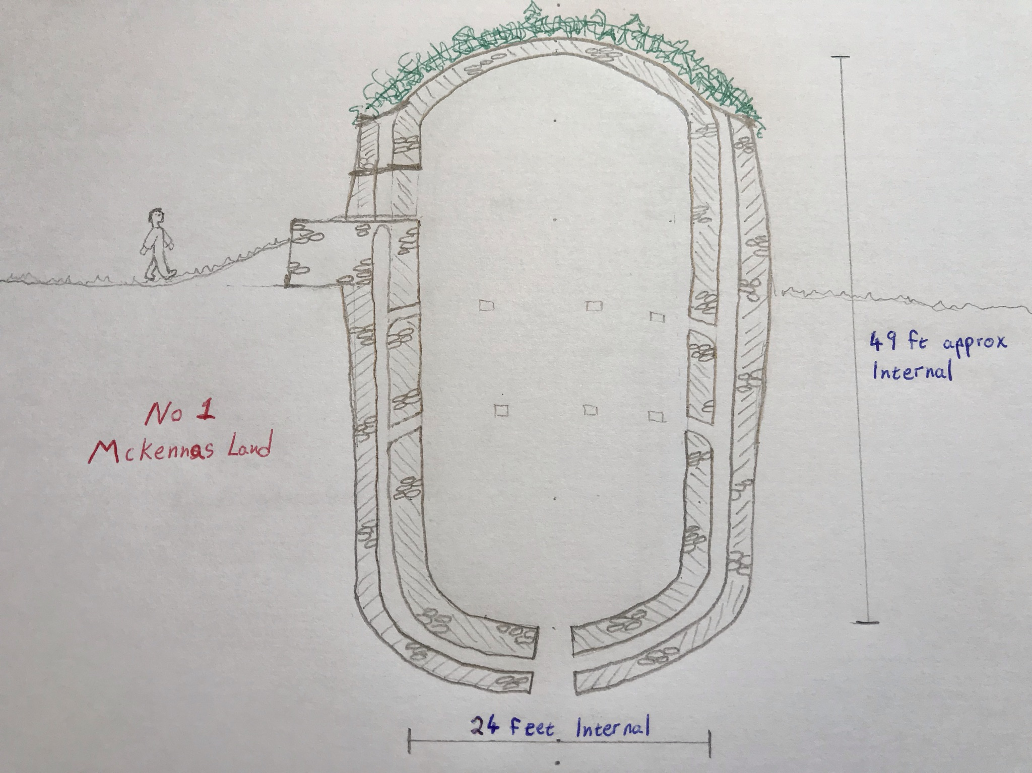
Capacity in Tonnes of Ice Houses
Halloran's
Overall internal volume = 10150 cubic feet.
Stocked to probable level = 230 tonnes of Ice
Murray’s
Overall internal volume = 17250 cubic feet.
Stocked to probable level = 365 tonnes of Ice
McKenna’s
Overall internal volume = 19500 cubic feet.
Stocked to probable level = 405 tonnes of Ice.
1000 tonnes combined

Slide 23
No 3 (Pat o Halloran's land)
Blue one. Summary.
Some damage to entrance doorway.(Stoned up at some point possible).
Some damage to outer wall either side of entrance.
Otherwise complete with domed stone roof intact.
Clay insulating layer on roof overgrown with vegetation.
Floor and drain filled in slightly with stones and vegetation decay (few feet).
Perimeter of structure overgrown with trees and vegetation.
4 large holes on east and west of structure (Beams for roof construction during build).
External cavity wall likely to have continued to bottom as opes present in internal walls.
Plausible original scaled cross section from west side.
(Brian Dunne 2022)

Slide 24
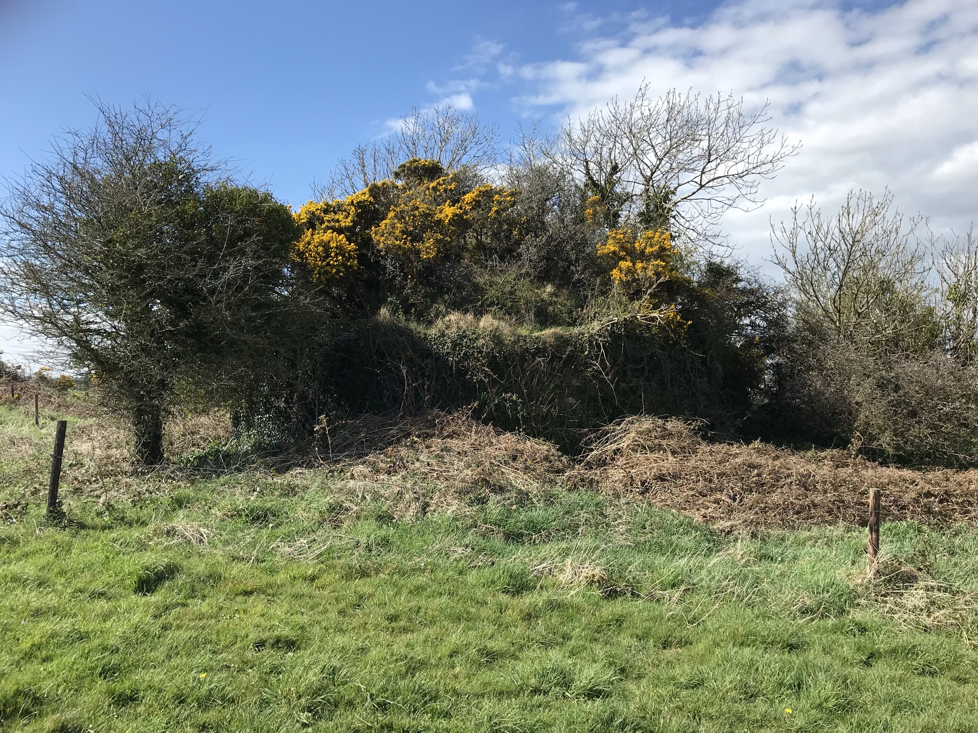
No 3 (Halloran’s) from East

Slide 25
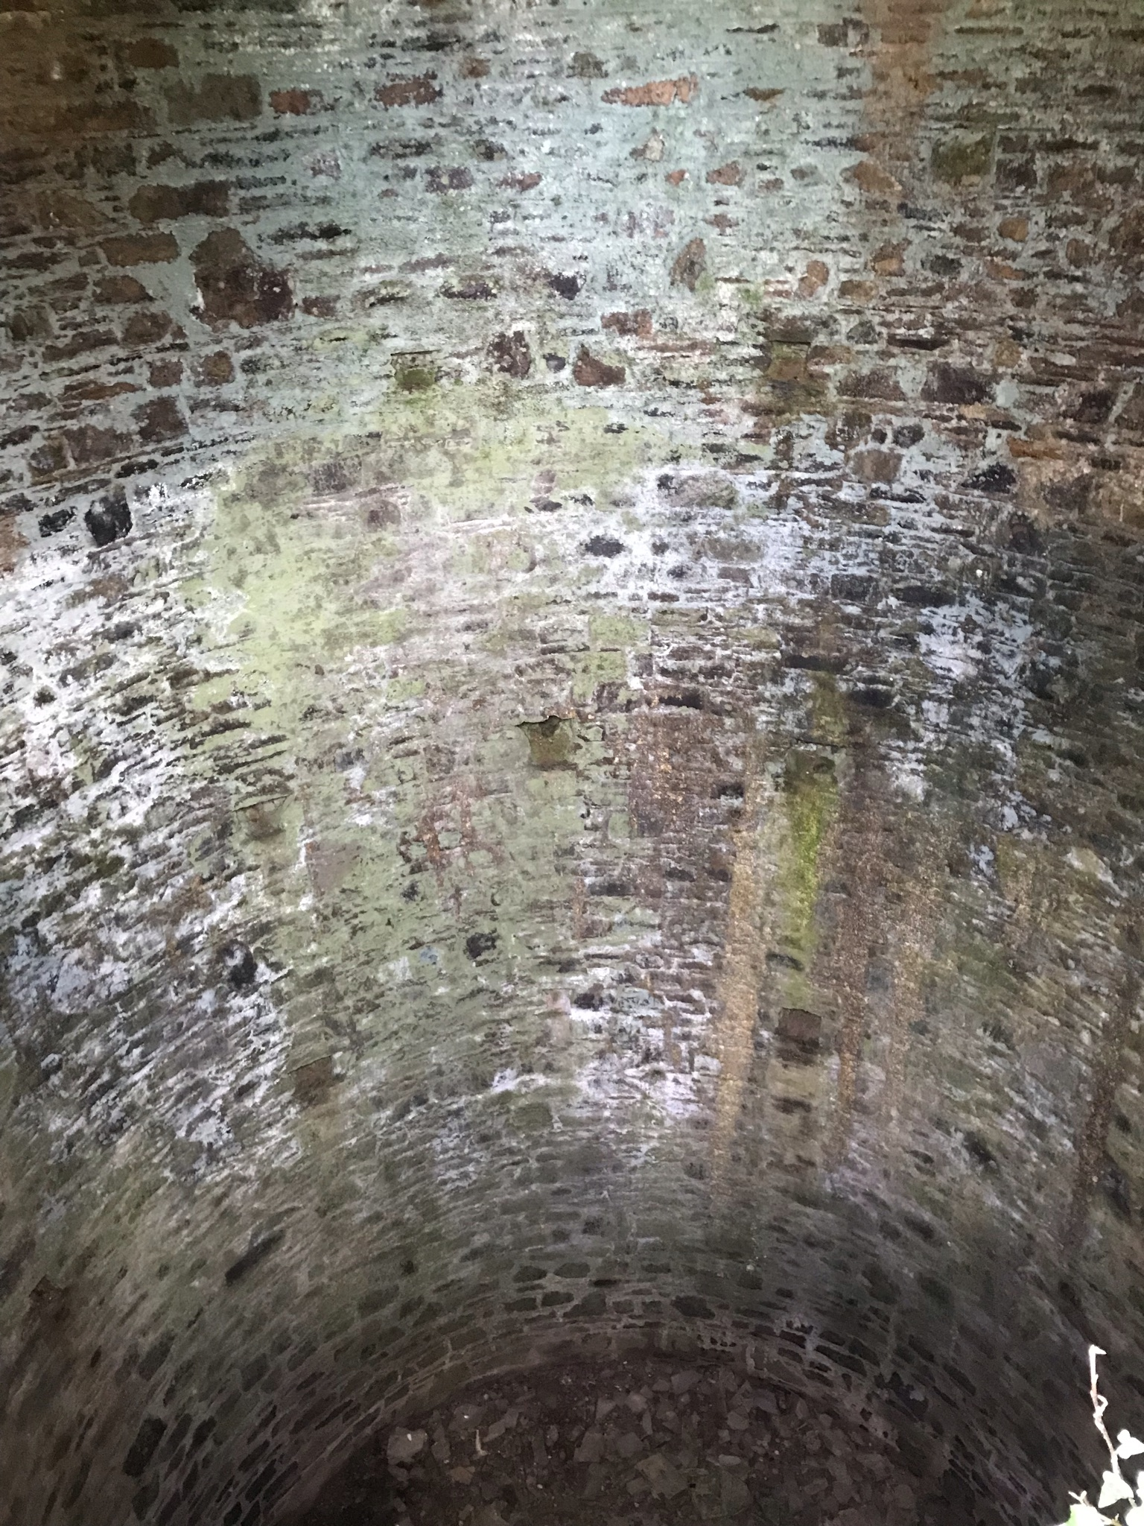
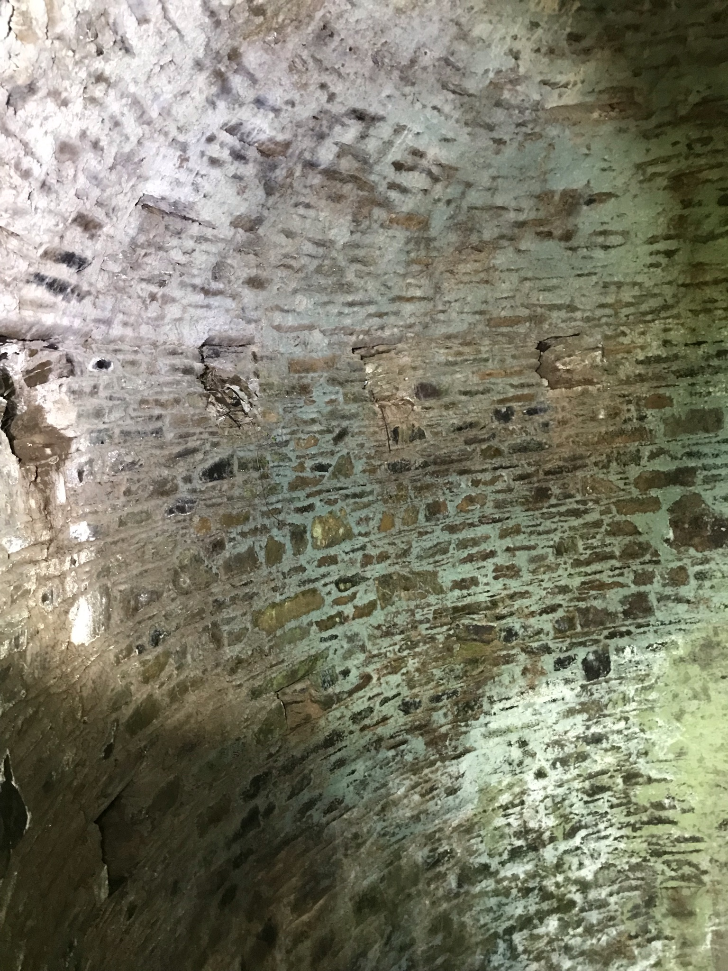
No 3 (Halloran's)
Ice chamber/pit
Openings for roof construction beams

Slide 26
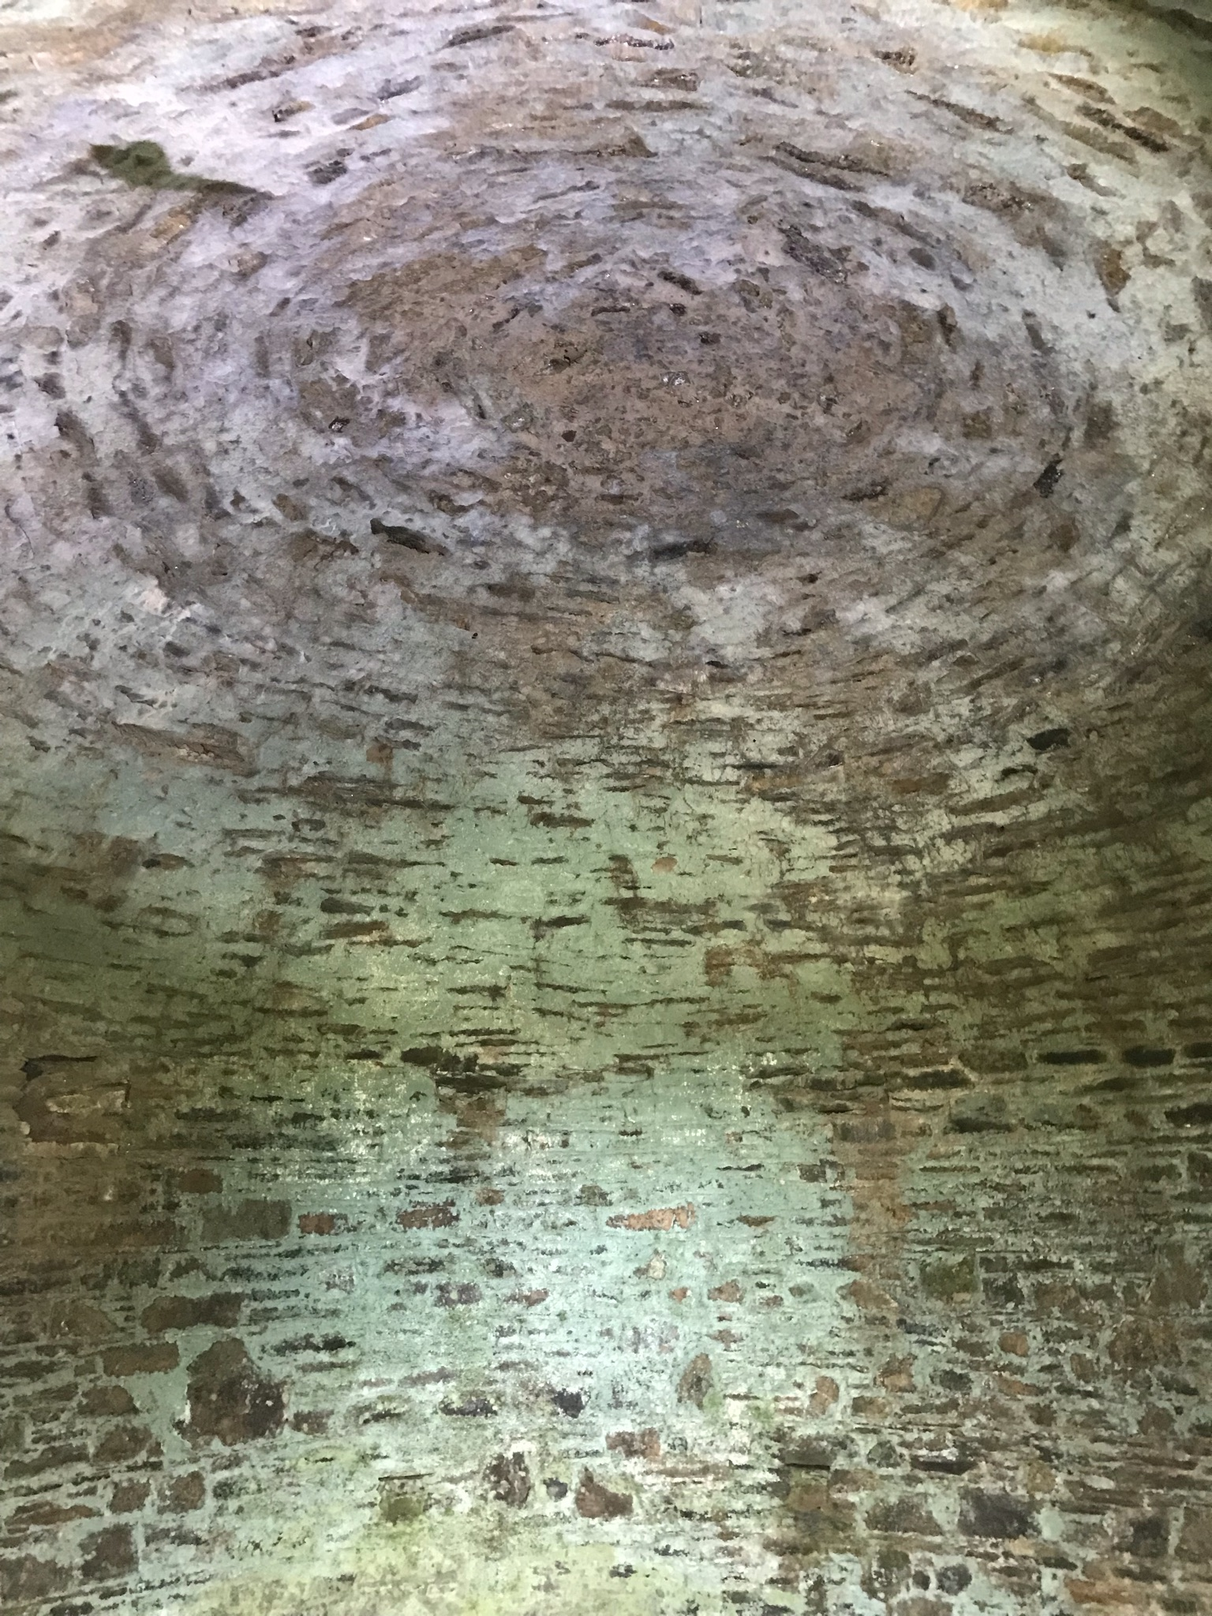
No 3 (Halloran’s) Domed stone roof

Slide 27
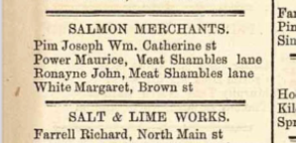
No 3 (Halloran’s) History
Richard Tobin's land.
Michael White and family owned the Ice House. They were fishmongers and salmon merchants with business in nearby Youghal.
Michael White may have been married to Margaret Tobin.
Other names associated with the ownership of this ice house were Margaret Tobin, Jeremiah Tobin, Mary Tobin and William O Neill at a later point.
Charles Devalmare was landlord/agent.
£10 rent in 1850s.
£5 rent in 1860s.
£2 rent in 1890s.
Down as vacant in 1889
and described as a long
time not used.
In 1889 revision book, would let for £2 a year, a long time not used.
Still nearly fully intact after possible 200 years.
Youghal directory 19th C

Slide 28
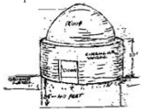
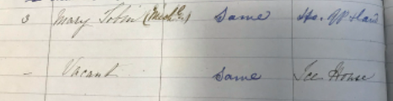
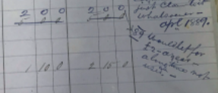
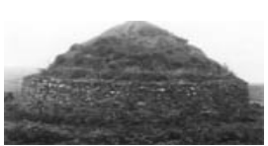
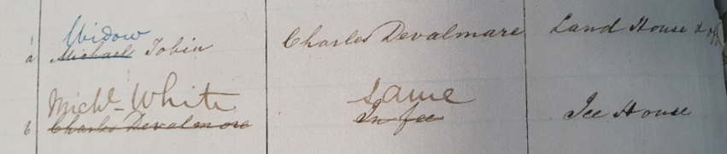

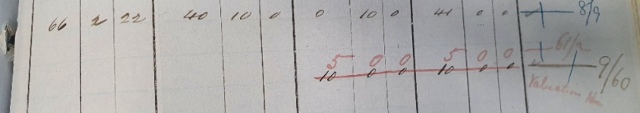
Topographical survey 1937
Topographical survey 1937
Griffiths valuation (Revision books)
Youghal directory 19th C

Slide 29
No 1 (McKennas Land)
Red one : Summary
Entrance doorway damaged, but large door head still present.
Roof has fallen in by 1930s.
Vegetation present all around upper walls.
Possibly 5-10 feet of debris, stones and vegetation decay in pit.
2/3 of external wall present.
Chamber internal walls in reasonable condition.
3 or 4 rows of sidewall drain holes visible.
Entrance doorway was 6 feet approx. from ground level.
Internal wall(2 ½ ft.)
Cavity (1 ft.)
External wall (1 ½ ft.)
Outer structure diameter ( 38 ft.)
Inscriptions on stone lintel over entrance.
Roof colapsed
Debris
Plausible original scaled cross section
from north west side. Current state marked.
Brian Dunne 2022

Slide 30
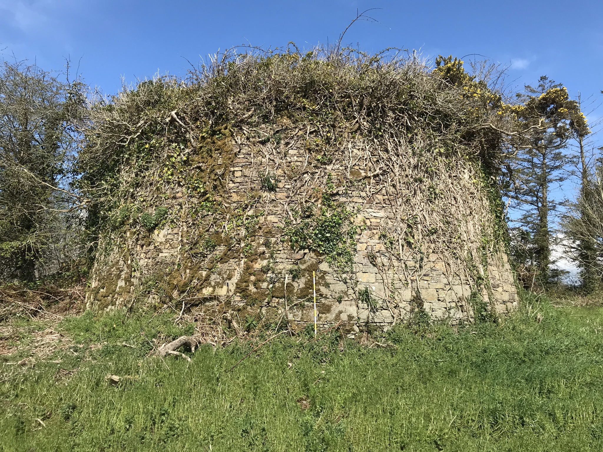
No 1 (McKenna's) from south side.

Slide 31
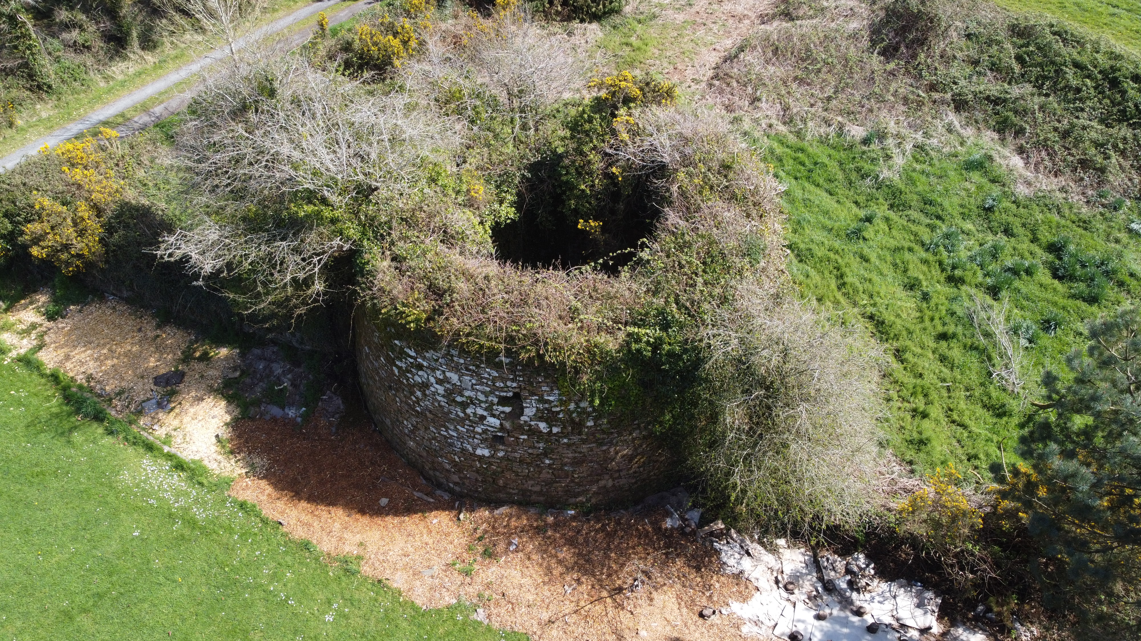
No 1 (McKenna’s) from North west.

Slide 32
No 1 (McKenna’s) History
This vast ice house’s original owner appears to be Maurice Power.
Richard Carey owned it in the later part of the 19th Century. Carey had numerous business’s in the town of Youghal, where he also resided.
Declan Tracey was the Landlord receiving rent for the ice house at the time under Kennedys Estate of Ballinamultina House in Clashmore.
Tracey was receiving £12 in the 1850s reduced down to £2 by 1890.
Curiously a Richard Farrell who owned ships, along with business’s all over Youghal started to receive the rent from Richard Carey. Farrell ran ships with cargo such as timber, coal, brick, seed and possible ice from his various dealings.
It was stated in Griffiths valuation revision book as being in ruins in 1911.
It was claimed in Lewis’s topographical survey that this was the last of the 3 Ice House’s in the parish to be worked.

Slide 33

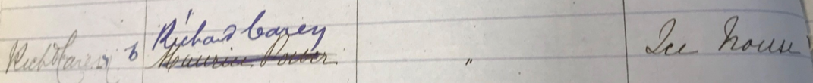
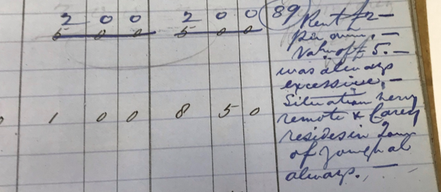
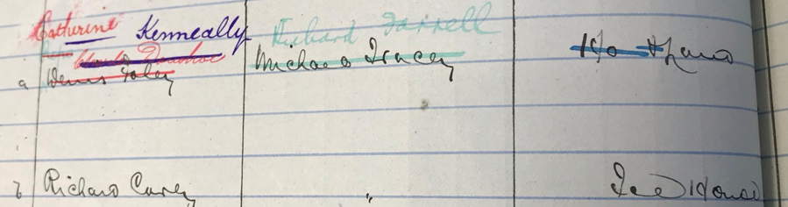
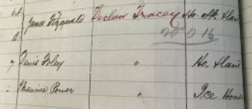

Griffiths valuation entry's
For Maurice Power
Richard Carey
Declan Tracey
Richard Farrell

Slide 34
No 2 (Murrays Land)
Green one : Summary
Both lower entrances are 5 feet above field level.
Both lower entrance doors have similar vaulted passageways(7/8 feet deep)
Upper single entrance in poor repair.
Upper tier and domed stone roof have fallen into pit.
Stones, vegetation and build up may be 15 feet in depth in pit.
Pit isn’t perfectly circular due to builders hitting rock.
Large quantity of damaging vegetation all over structure.
55 foot diameter lowest tier in good condition.
Second and third tier in poor but stable condition.
Upper tier and domed roof have fallen in.
Debris
Plausible original scaled cross section
from north side. Current state marked.
Brian Dunne 2022

Slide 35
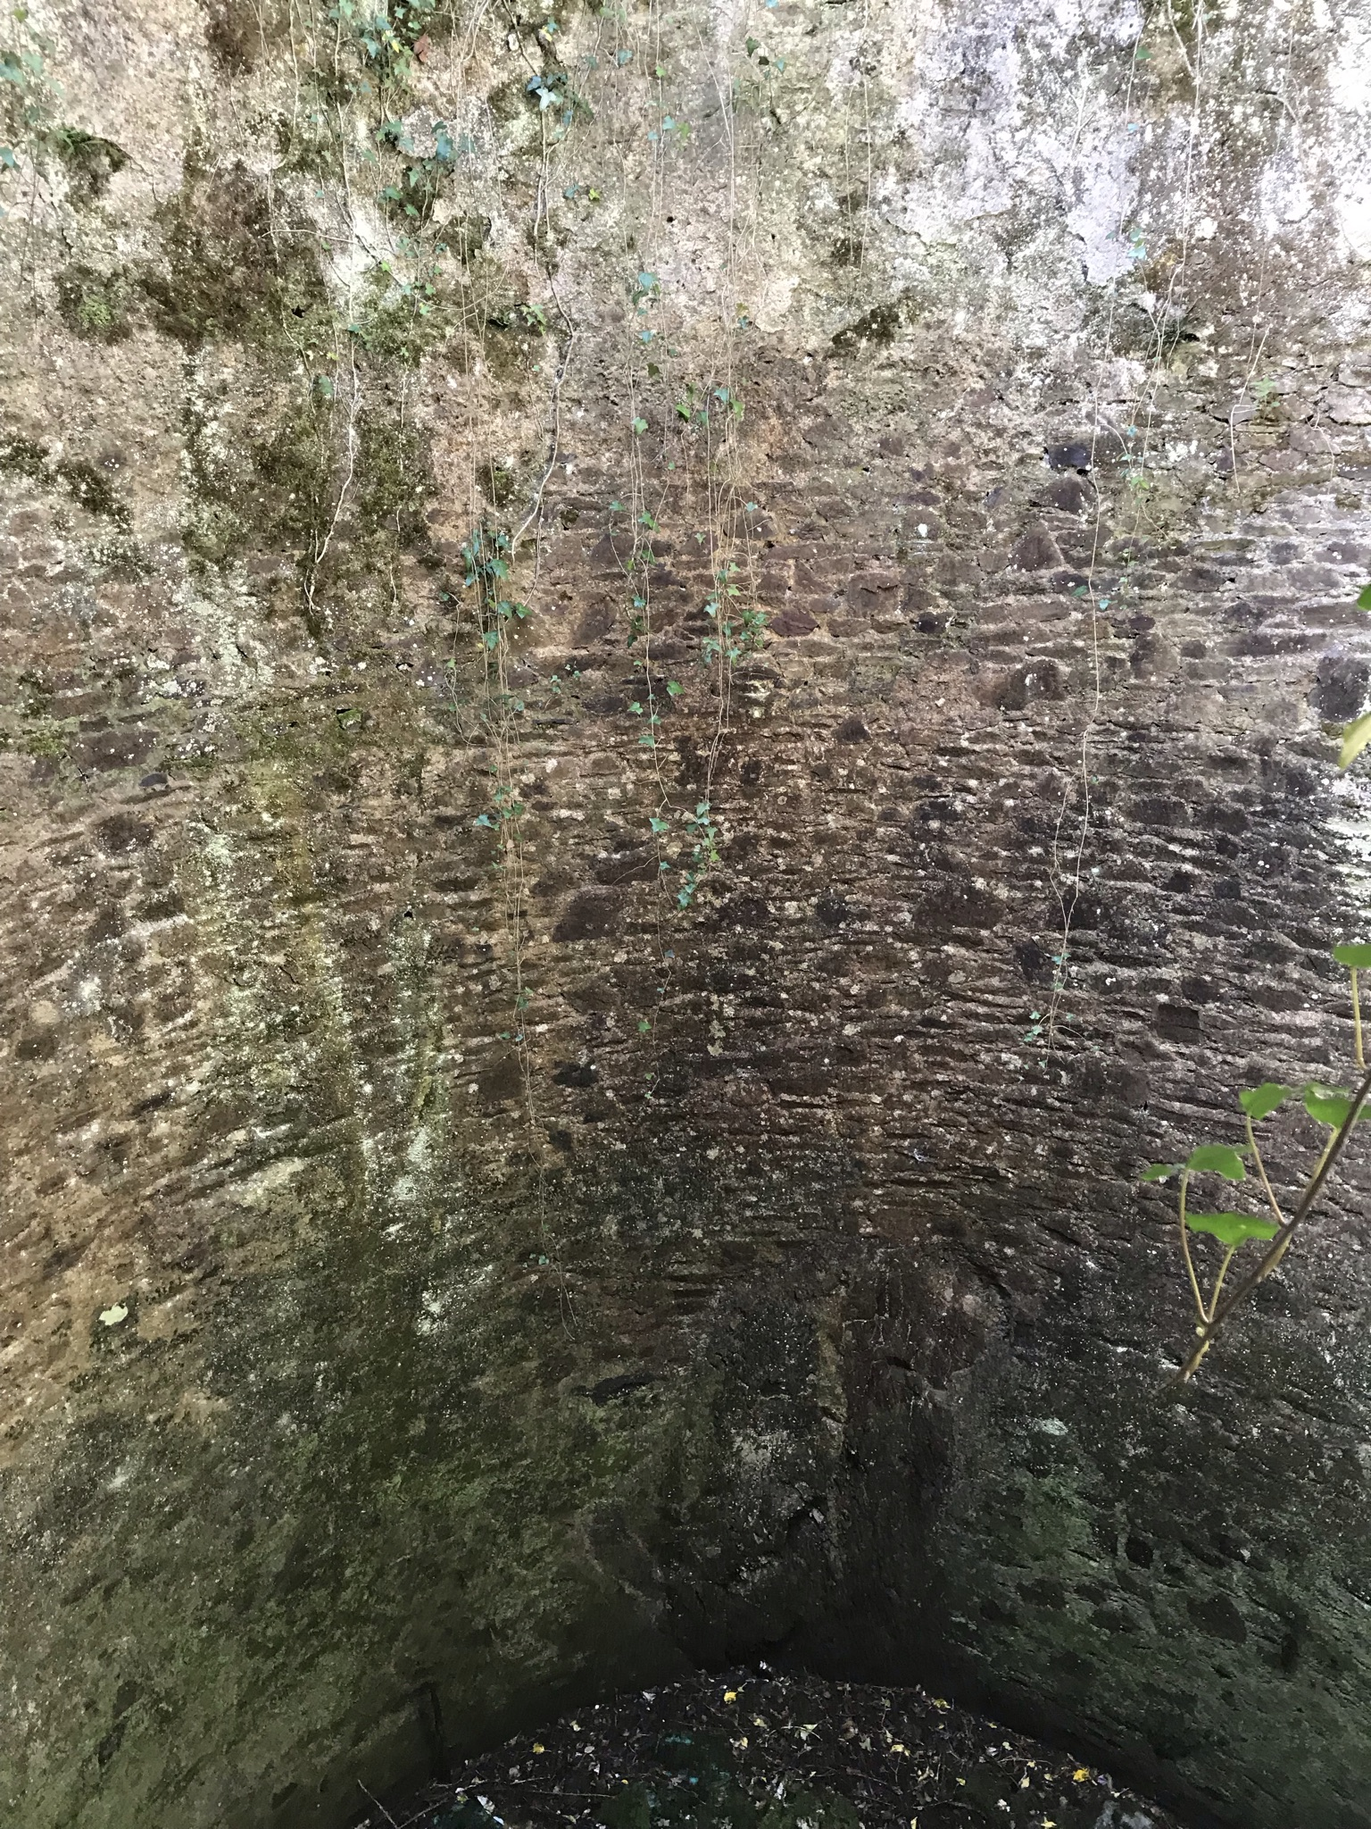
No 2 (Murray’s) with solid rock visible in chamber wall.

Slide 36
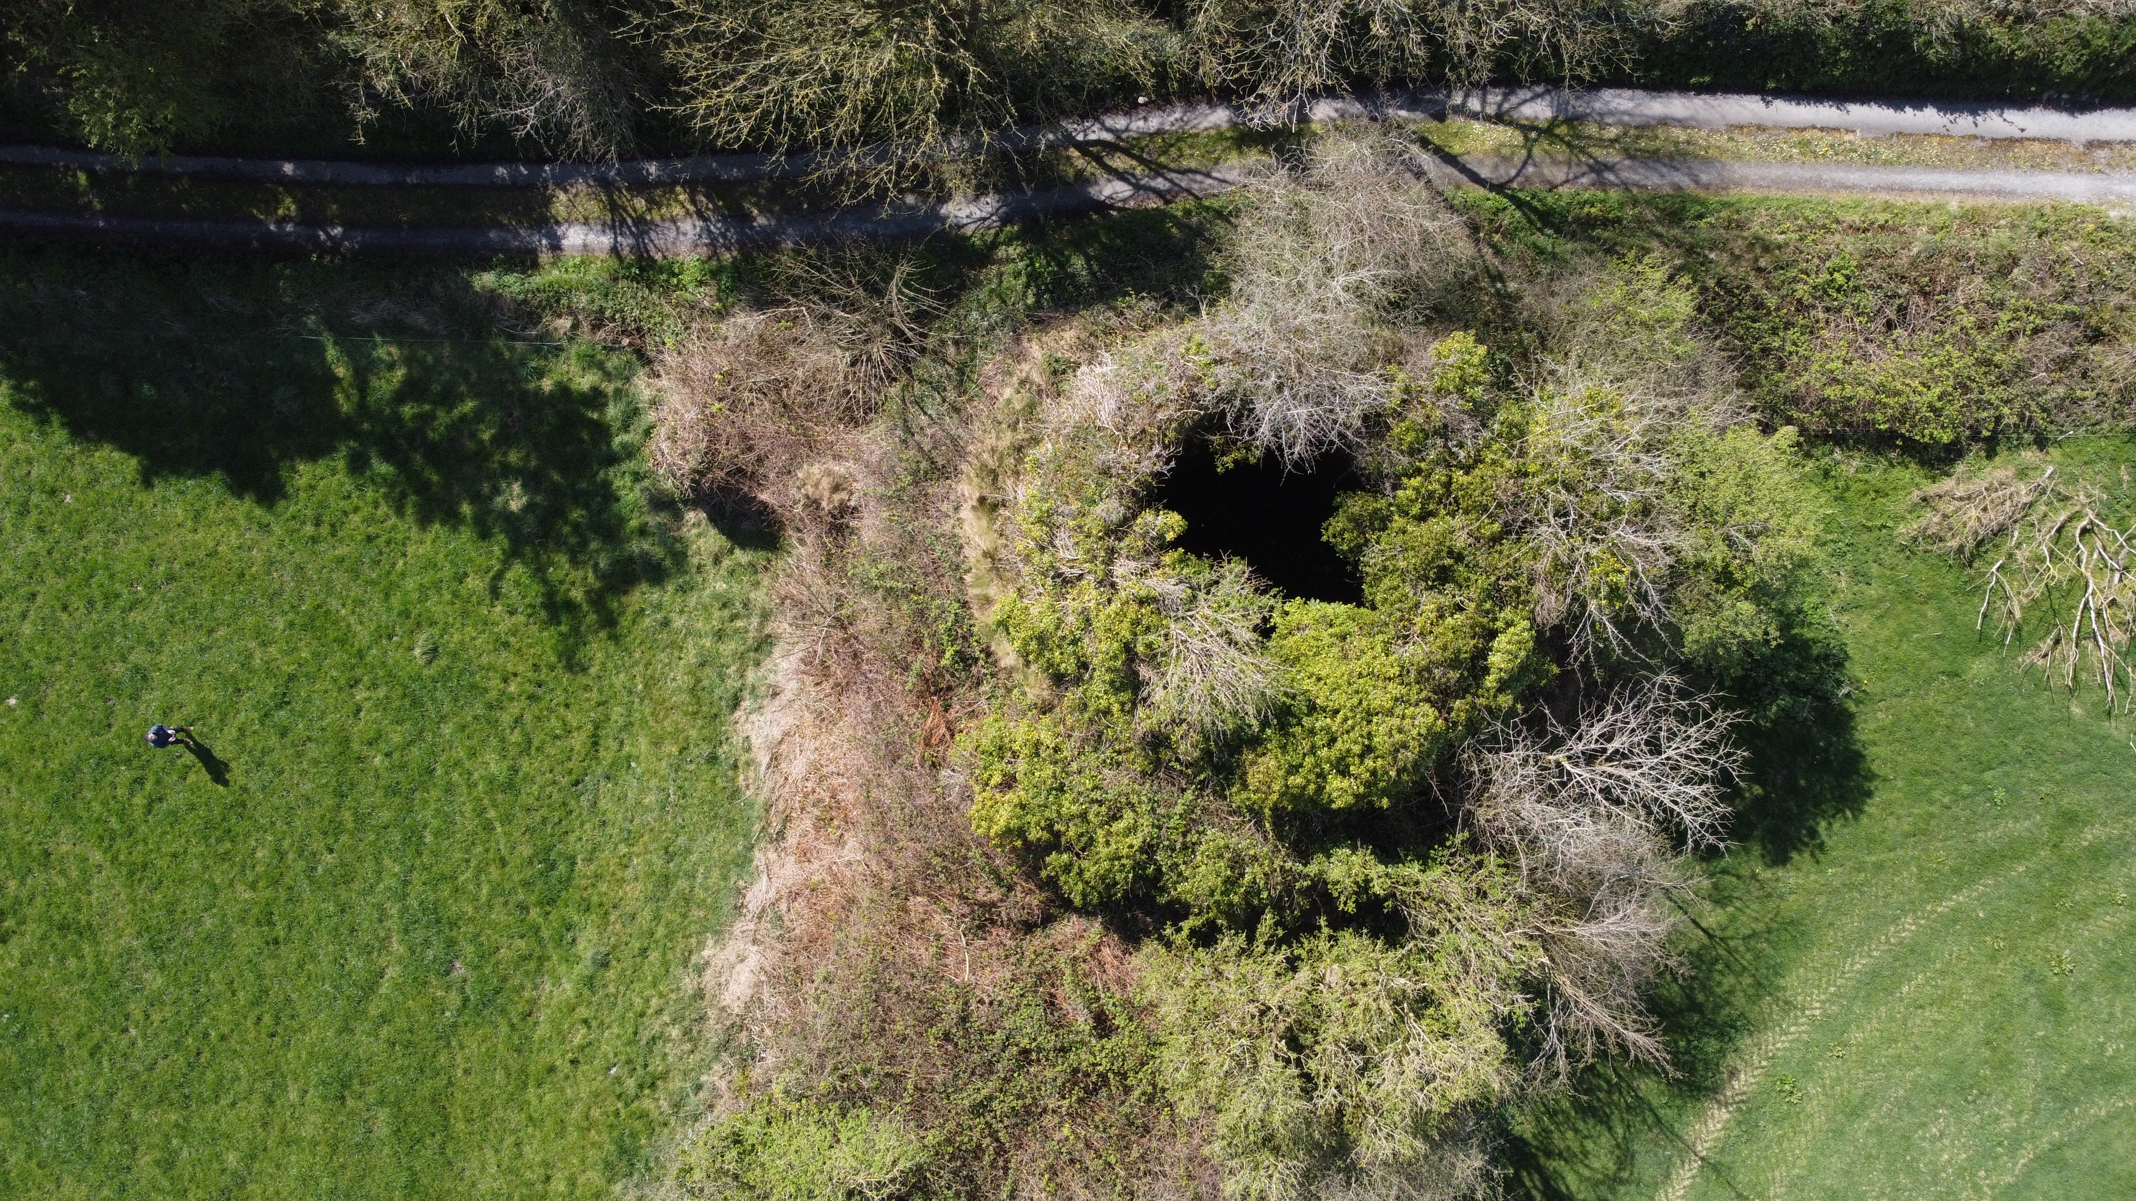
No 2 (Murray’s) Aerial shot.

Slide 37
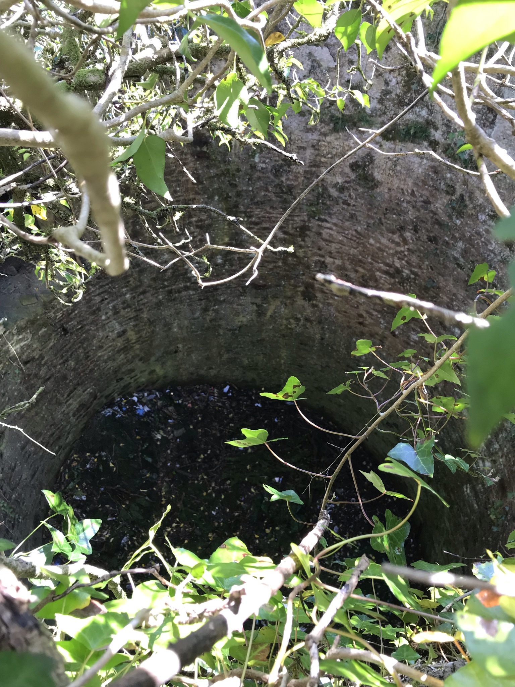
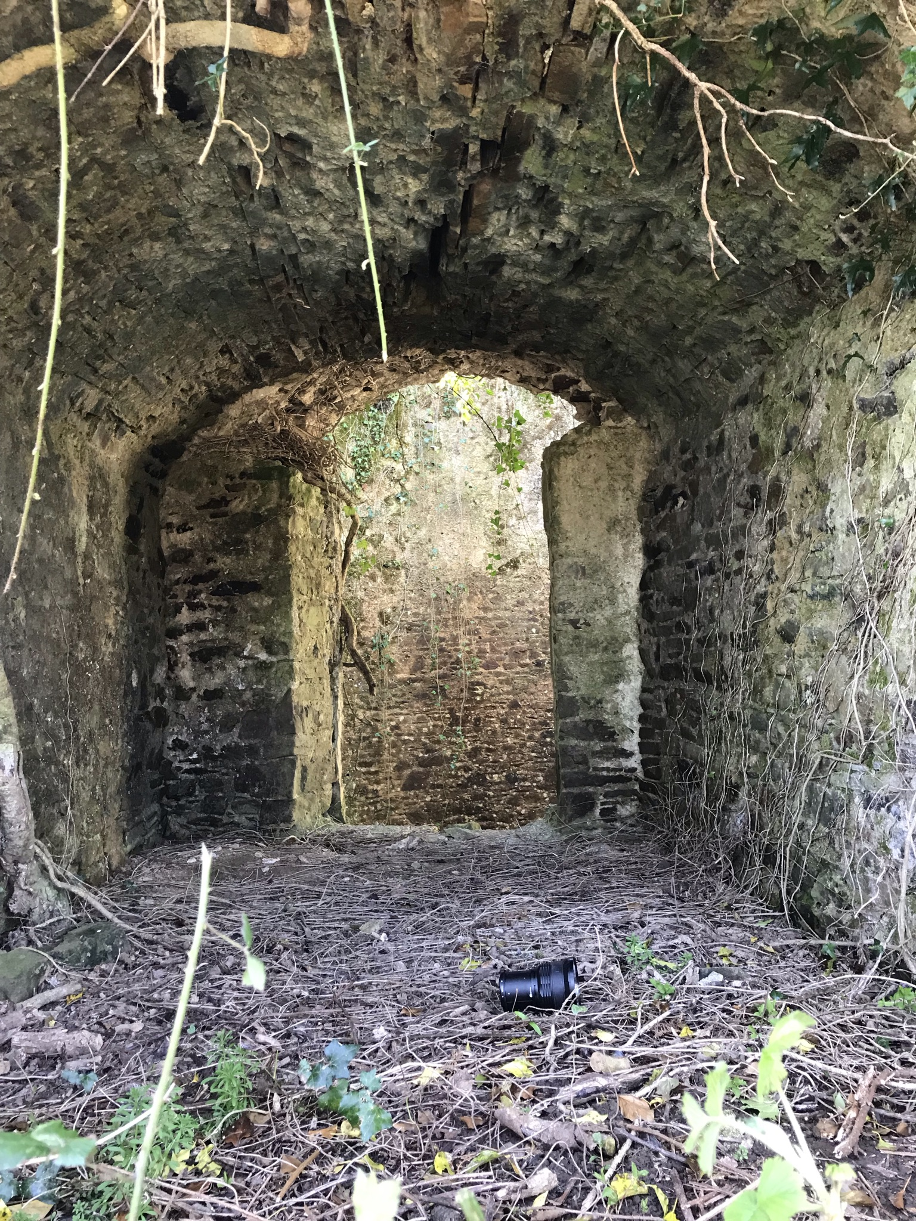
No 2 (Murray’s) from upper tier. First of the three entrances (bottom left)

Slide 38
No 2 (Murray’s) History.
This very large Ice House was always owned by John Ronayne of Ardsallagh House on the banks of the Blackwater in Waterford.
John Ronayne had other business’s in Youghal town including running steamer boats up and down to Cappaquin with trade goods. He was also a fishmonger, salmon merchant on top of the home farm.
Rent paid to Declan Tracey was £8 in the 1850s, reduced to £5 by the 1870s.
In 1891 it is stated this ice house is not in ruins as reported, but has not been used for some time.
The Youghal merchant Richard Farrell is marked as lessor in 1899 with £5 dues being paid by John Ronayne’s wife Alice Ronayne at this point.
Structure is marked in the Griffiths revision books as in ruins in 1905.
A topographical survey from 1937 states the domed roof has fallen in as well as the section of the upper tier above the upper doorway.

Slide 39
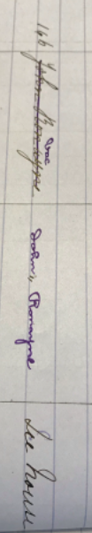








Slide 40






Topographical survey 1937
Topographical survey 1937

Slide 41
Summary
Very unique trio of Ice Houses who’s stature is aided by their close proximity to each other.
All three are very large even on a national level.
The commercial aspect of these structures highlights the large scale ice industry that our parish once had, whilst also generating the question as to weather any other parish in Ireland had 1000 tons of ice at its disposal in the 19th century.
Their importance is also aided by how uncommon they were even in the 17 and 1800s, with only a few dotted around the country then and now( possible 200-300),the vast majority of these would have been small ice houses connected to the landed estates.
All three are slowly eroding away into the ground with vegetation and root growth the main issues.
Halloran’s one is still in excellent condition, with the chamber itself amazing to see with the roof still on, McKenna’s one is unique due to the vast internal size of the original structure with Murray’s tiered Ice house’s overall day one exterior measurements being hard to get your head around.
Overall a very important part of our history and heritage in Clashmore and Kinsalebeg and I hope this presentation brings them into the light they deserve.
Brian Dunne 2022.

Slide 42

Bibliography
Ardsallagh House: https://waider.ie/personal/hairballs/ardsallagh_house.html
Ice House History: https://theirishaesthete.com/2016/08/13/ice-ice-baby/
Youghal Directory: http://youghalcelebrateshistory.com/cms/wordpress/wp-content/uploads/2013/11/Youghal1881-21.pdf
Historic Environment Viewer: https://maps.archaeology.ie/HistoricEnvironment/
Tides and Talles, Icehouses: https://tidesandtales.ie/the-ice-house
Discover Clashmore: http://www.discoverclashmore.com/history.html
Woods Hole Museum: https://www.woodsholemuseum.org/icehouse/index.html
Survey of the Ice House at Mount Stewart Demesne: https://www.qub.ac.uk/sites/uas/UASfilestore/CoDown/Filetoupload,724604,en.pdf
Petworth House Ice House: http://www.icehouses.co.uk/petworth.htm
History of Refrigeration, Ice House History: http://www.historyofrefrigeration.com/refrigeration-history/history-of-ice-houses/
Kinsalebeg Placenames: http://kinsalebeg.com/chapters/placenames/placenames.html
Canon Power’s Placenames of the Decies: http://snap.waterfordcoco.ie/collections/ebooks/106325/106325.pdf
Youghal Town Atlas, Tadgh O’Keeffe & David Kelly: https://www.ria.ie/irish-historic-towns-atlas-online-youghal
Parlington Hall Ice-House: https://parlington.co.uk/ice_house_h7.html
National Archives of Ireland: https://www.nationalarchives.ie/
Griffiths Primary Valuation: https://askaboutireland.ie/griffith-valuation/
Blackwater & Bride Navigation and Tade, 7000 BC to 2007, Niall O’Brien, 2008
Technology and the Big House, Charles J.T. Carson, 2009
I.T.A. Topographical and General Survey, 1937
Photo Credits:
The Horgan Collection, Youghal Library, Youghal Co. Cork
Aerial Drone Photographs, Brian Dunne, Clashmore, 2022
Ice House Photos, Science Photo Library: https://www.sciencephoto.com/media/679491/view/ice-house-19th-century
Carnfunnock Ice House Photo: https://www.geograph.org.uk/photo/797983
Lismore Ice House Photo: https://www.geograph.org.uk/photo/1916586

